Slide 1
7th and 8th Grade Curriculum Night
Welcome!
*The information in this PowerPoint is as of 8/16/2018 and is subject to change at any time at the teacher’s discretion*

Slide 2
7th & 8th Grade Writing

Slide 3
6+ 1 Traits of Writing & The Writing Process
6 +1 Traits
Ideas and Content
Organization
Conventions
Voice
Sentence Fluency
Word Choice
Presentation
Writing Process

Slide 4
Types of Essays
Narrative- Tells a Story
Expository- Seeks to explain
Argumentative- Paired with the Debates
Research Paper- Use multiple outlets to look for research and put together a cohesive paper

Slide 5
Homework
Grammar worksheets- review of grammar concepts reviewed in class
*Diagramming will be given when the time is right
Practical Writing- less worksheets and more functional practice of writing skills that we learn

Slide 6
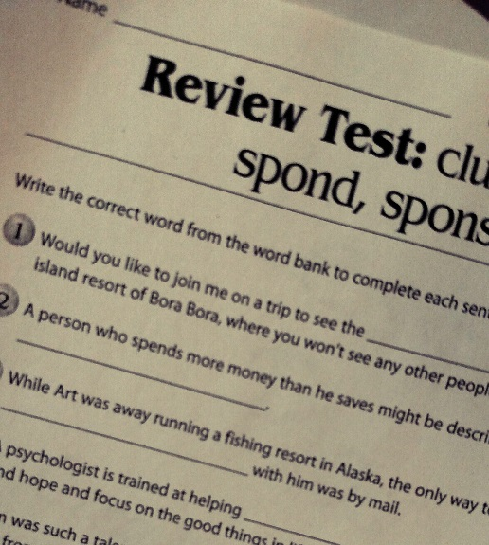
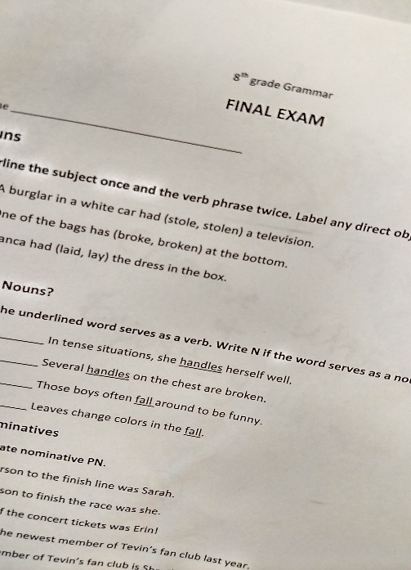
Quizzes and Essays
The kids will be notified well in advance.
Quizzes will cover mostly grammar.
Essays

Slide 7
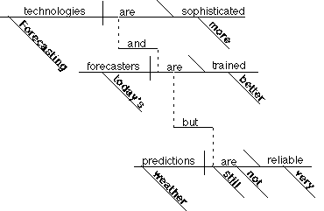
Why diagram sentences?
Sets structure
Analyzes
Synthesizes
Compare/contrast
Identify parts-of-speech
Self editing skills
Critical thinking skills

Slide 8
7th and 8th Grade Literature
Mr. De La Cruz

Slide 9
Curriculum
7th Grade: The Elements of Literature, First Course, by HRW.
Roll of Thunder, Hear My Cry, The Giver, A Christmas Carol, Nothing But the Truth, The Hobbit, TBA
8th Grade: The Elements of Literature, Second Course, by HRW.
The Outsiders, To Kill a Mockingbird, Twelfth Night, Animal Farm, The Diary of Anne Frank

Slide 10
Grading Policy
Essays/Projects/Presentations – 40%
Quizzes – 30%
Homework – 30%
Following directions!

Slide 11
Homework/Late Work
We will be having homework regularly. I do not accept late work or incomplete work.

Slide 12
Regular Assignments
Vocabulary (High frequency/SAT type words)
1 new word every day
A quiz will be given every Friday
Units contain 20 words, so quizzes are cumulative until we reach 20. Then it starts over again.
Vocabulary Bell Work is checked and counted for a grade. Students are still responsible for completing vocabulary when they are absent.

Slide 13
Regular Assignments
Poem Memorization
One poem a month (list posted on Weebly). First recitation is September 6. Students must have accompanying paperwork.
Book Reports
One book report a quarter. All book reports completed IN CLASS, using only the book. Book report books MUST come from approved list. Books are due August 24

Slide 14
Class Website!
I will post all downloadable forms on our Weebly page.
All other information will come from my lesson plan emails!

Slide 15
7th and 8th Grade Science
Ms. Brasher

Slide 16
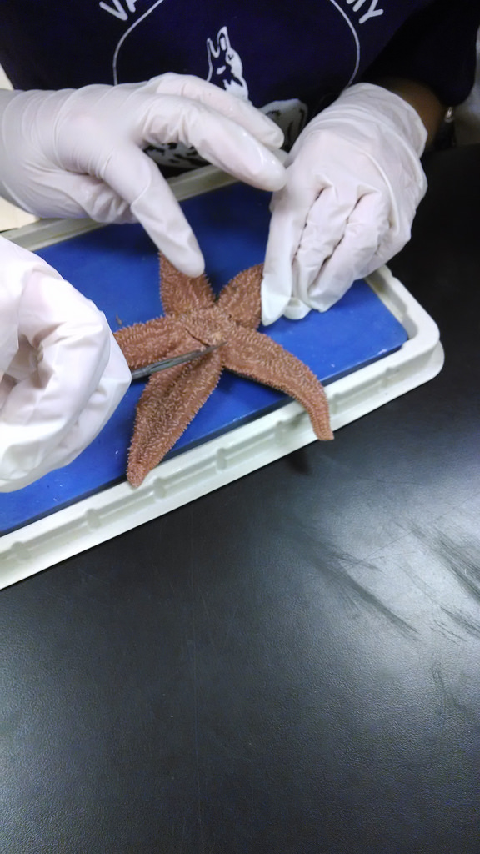
7th Grade Units
Life Science
Cell Biology
Botany
Zoology
Ecology
Genetics

Slide 17
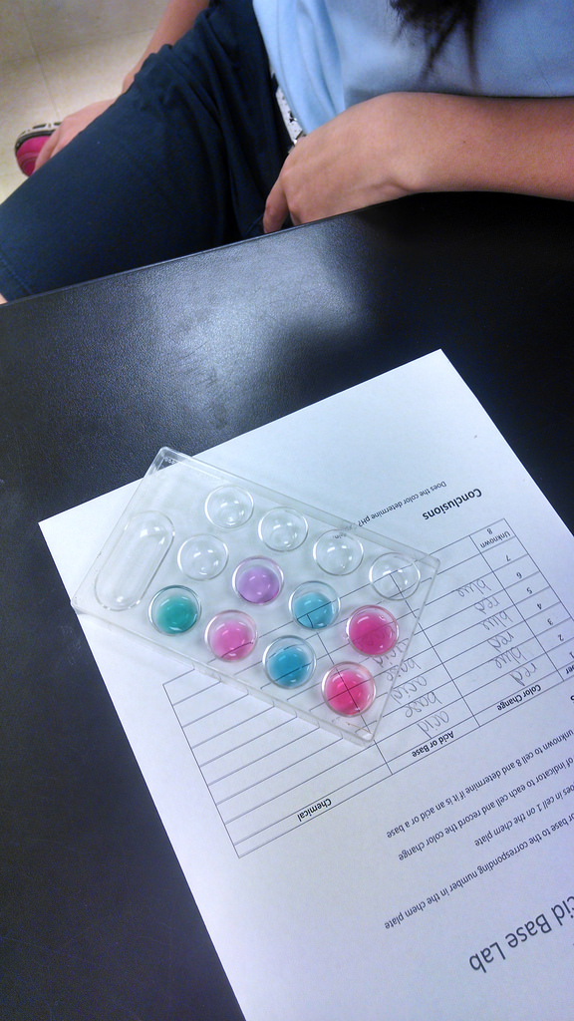
8th Grade Units
Physical Science
Chemistry-Matter
Chemistry-Atoms and the Periodic Table
Physics
Energy
Forensics

Slide 18
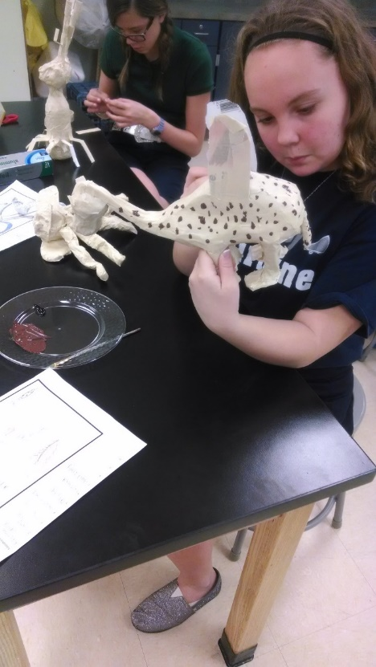
Science Units
Each unit consists of between 5 and 10 lessons.
Some units are longer and will take more time.
It takes about a week to complete a lesson.
It takes between 4 and 9 weeks for the units.

Slide 19
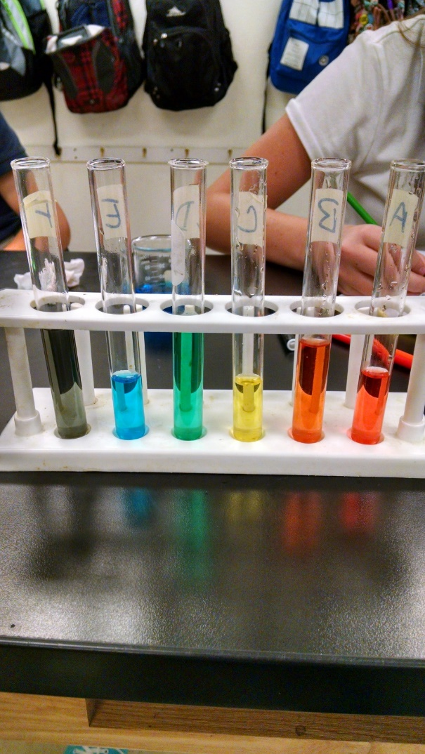
Hands on Science
Valley Academy is committed to an integrated, hands-on science curriculum.
We will do an activity or lab for every lesson.
We generally have a lab or activity every week.
Some lessons have multiple activities and labs.
There are long term projects that take between 3 and 6 days.

Slide 20
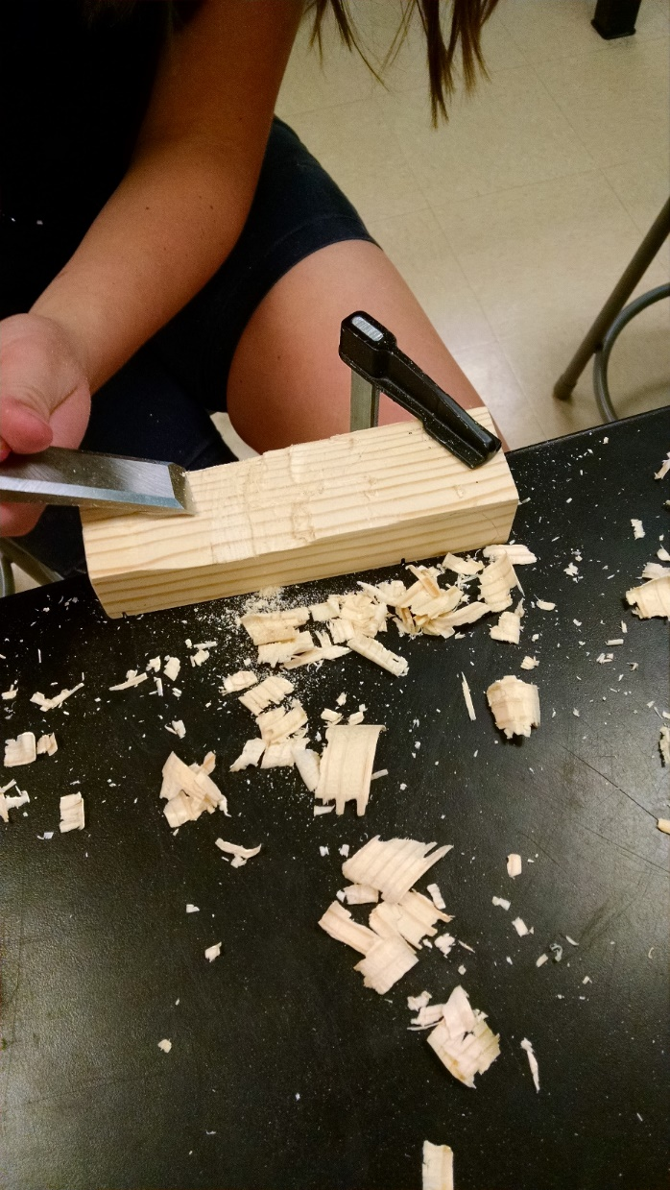
Grading
Practice 50%
Quizzes 20%
Exams 30%

Slide 21
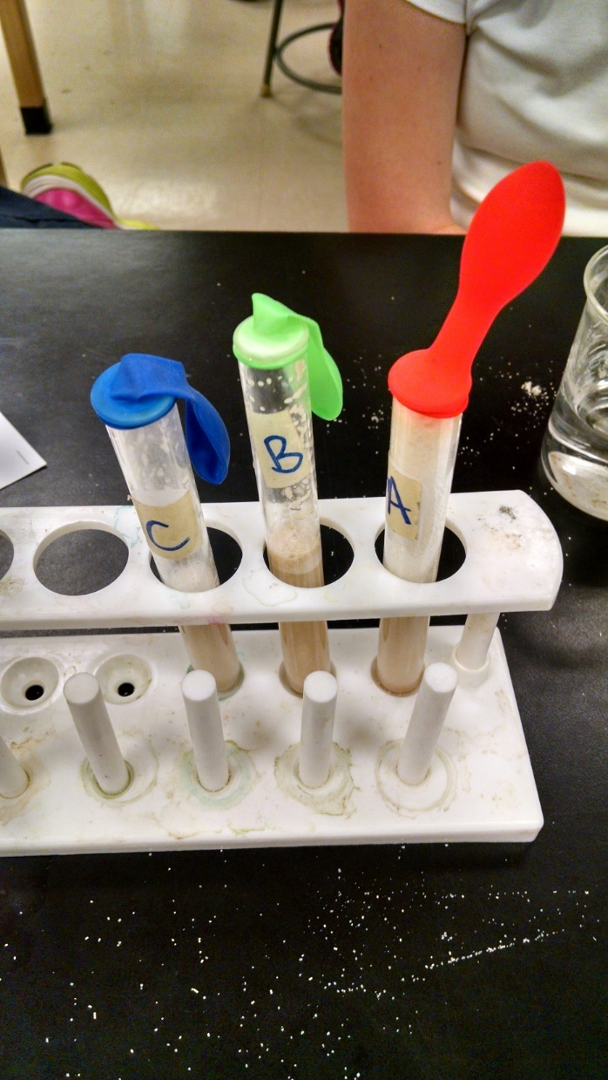
Practice
Practice Packets Include:
lecture guide
review
critical thinking
concept map
crossword/word search/scramble

Slide 22
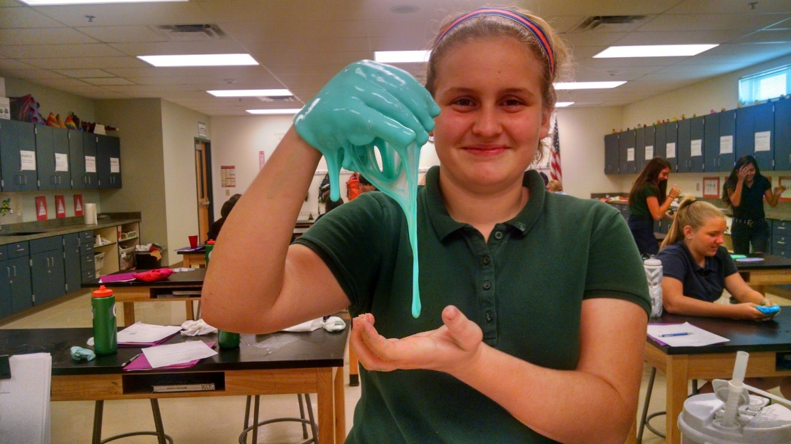
Lecture Guide
Follows the lecture in order.
Asks for vocabulary definitions and concepts.
Answers are found in the lecture packet.

Slide 23
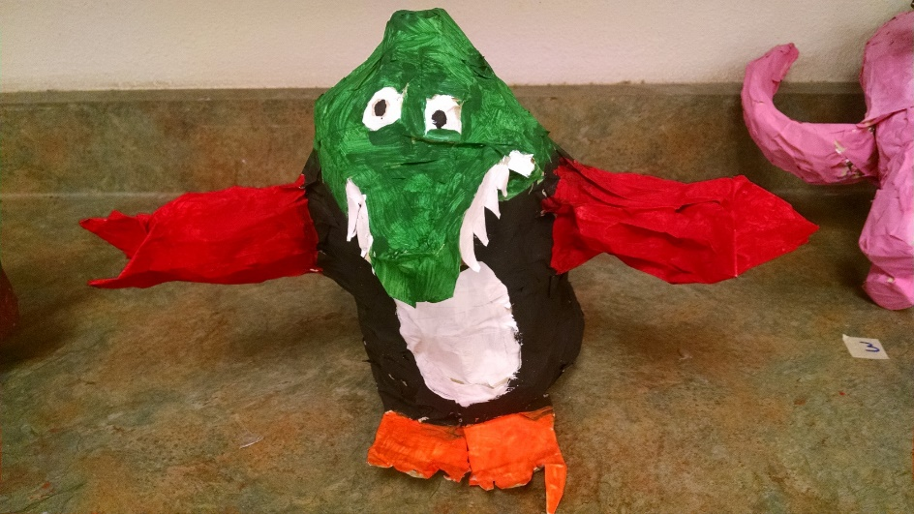
Review
Approximately 50-70 questions.
multiple choice
fill in the blank
matching
true/false
Answers are found in the lecture packet

Slide 24
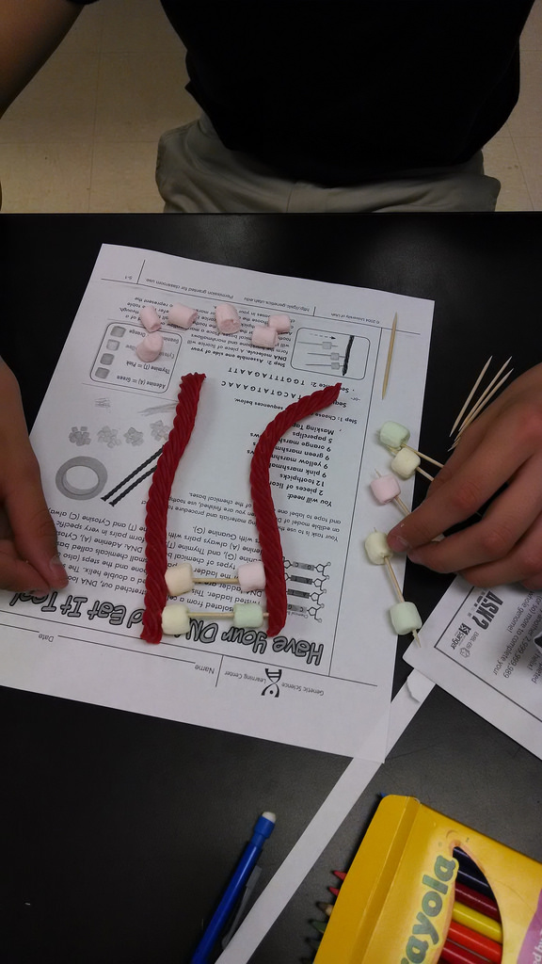
Critical Thinking
10-20 Short Answer Questions
Focus is on connections and relationships.
Answers are found in the lecture packet and from the student’s understanding of the material.

Slide 25
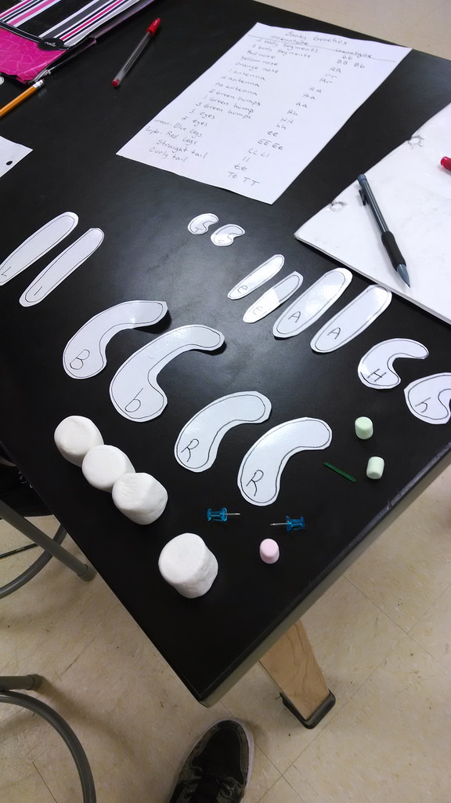
Concept Map
Students place vocabulary and concepts into a hierarchy or relationship diagram.
Focus on relationships and connections.
Vocabulary questions and critical thinking questions are also included.
Answers can be found in the lecture packet and from the student’s understanding of the material.

Slide 26
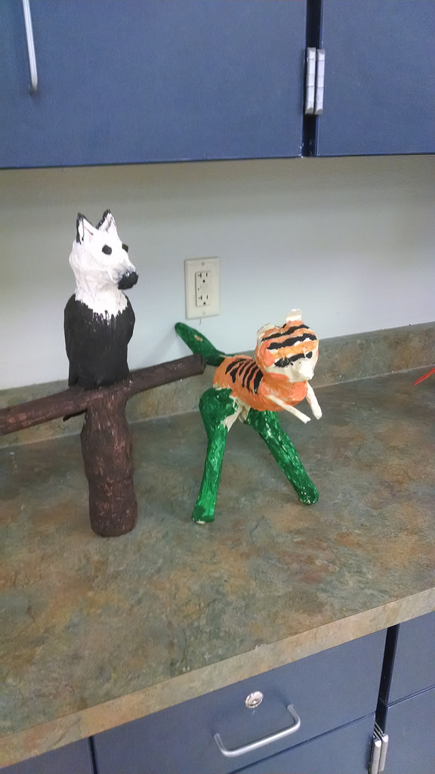
Crossword-Word Search-Scramble
These types of assignments reinforce the vocabulary.
The word search and scramble are a passive way of learning the vocabulary.
There are questions at the end of the scramble that students MUST answer.
Crosswords are effective because they are self-correcting.

Slide 27
Purpose of Practice
Students are given a lot of practice meant to teach the material.
I will lecture on the lesson, but the vast majority of the learning happens during the practice.
Students who do well on the practice will do well in the class.
I emphasize “Perfect Practice Makes Perfect”
Students should strive for perfection when working on the practice.

Slide 28
Quizzes
There are two types of quizzes given on the same day.
The first is multiple choice and matching.
The second is short answer and critical thinking.
Students are given the vocabulary for the quiz on the first day of the lesson.
They can begin studying on day one of the lesson.
Most lessons are 4 or 5 days long
The best way to study for quizzes is to do the practice.

Slide 29
Exams
Exams are given at the end of each unit.
They consist of 100 multiple choice, matching and true/false questions.
A study guide in the form of a fill in the blank review will be given prior to the exam.
Students should study the exam review and their lecture packets.

Slide 30
7th and 8th Grade Math
Mr. Hayo

Slide 31
7th Grade Math
Textbook: Saxon Math: Course 3 (2007)
Other source material will supplement the text.
This is a review of arithmetic and a very good introduction to the foundations of algebra.
Much emphasis is placed on the mastery of decimals, fractions, per cents, one and two-step equations, exponents, graphing linear functions, the Pythagorean Theorem, proportional thinking, and, of course, mastering word problems.
Students who excel in this class will qualify for Math 8 Honors in the 8th grade.

Slide 32
Math 8 & 8H: Algebra Foundations
Textbook: All 8th graders will be using the Saxon Algebra 1 (2009) textbook. Because of the changes in the Arizona Standards, many topics from Algebra are incorporated into the state tests. This book will serve as the basic text. In addition, we will use supplementary materials to explore and expand mastery of Arizona State Standards and prepare student.
Students will explore concepts in: integer operations, functions, probability, special right triangles, linear graphing and equations of lines, inequalities, scientific notation, word problems, and many other math concepts. Other topics from algebra include simultaneous equations, and finding midpoints and distances given two points.
Students who demonstrate excellent mastery of the topics may be recommended for placement in an Algebra Honors class in high school.

Slide 33
Grading
10% - Practice (Homework/Classwork)
45% - Skills Test
45% - Saxon Tests
Portfolio: students will maintain a math 3-ring binder this year. They will save examples of their work, including: activities, homework, outlines, quizzes, and tests. When they register for high school, they should take the binder with them to show what they have accomplished and the quality of work they do.

Slide 34
Attention Parents!
Neatness, Organization and following directions are important.
Please check student work on a regular basis and emphasize quality.
It is a good practice for you to check their homework, tests and vocabulary.
Help them see math in the real world: shopping, paying bill, taxes, tipping, interest rates, etc.

Slide 35
More Info
During the school year, students will have the opportunity to complete a number of activities and tasks to improve their “understanding” of math concepts.

Slide 36
If a student needs help…
It is important that the parent, student, and teacher work together for success.
Please check homework, tests grades, etc.
If your child is having difficulty, please contact me as soon as possible
The earlier we define a weakness, the better chance we have to correct it.
Math Resources: Khan Academy.org., IXL through school

Slide 37
2018-2019 MMXVIII-MMXIX
It is going to be a great – fun – year in Math!!

Slide 38
7th and 8th Grade Social Studies
Mrs. Simon

Slide 39
Grading
Homework/Practice
Classwork/Journal
Quizzes/Tests
Projects/Current Events
20%
20%
30%
30%

Slide 40
7th Grade Curriculum
First Quarter:
US & World Geography
Physical Geography
Second Quarter:
Civil War
Reconstruction
Third Quarter:
Gilded Age
1st and 2nd Industrial Revolution
Immigration
Progressive Movement
Imperialism
WWI
Fourth Quarter:
1920’s
Great Depression
Economics
Personal Finance

Slide 41
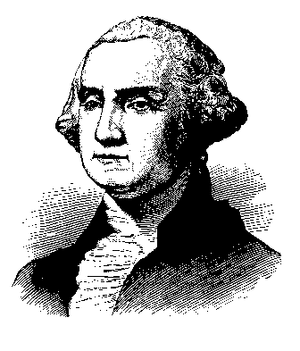
8th Grade Curriculum
First Quarter:
American Revolution
Birth of a New Nation
Government
Second Quarter:
3 Branches of Gov. study
Constitution Test
Third Quarter:
WWII
Holocaust
Cold War
Korean War
Fourth Quarter:
Vietnam
Civil Rights Movement
1960’s – 2000’s
Kennedy – Obama
“We Didn’t Start the Fire”
WDSTF Museum

Slide 42
Content is taught using Reading and Writing
Reading Comprehension
Writing
Students must be able to show where they found their answer in the texts (provide evidence)
They do this by highlighting where they found it or giving the page and paragraph number.
All students must restate their answers in complete sentences.
Every exam has at least 3 short essay responses, most quizzes will too.

Slide 43
Assignments
We DO NOT accept late work.
Homework:
These are normally worksheets we start in class and are finished at home
Quizzes
Multiple choice/Matching
Short Essay Answer
Projects:
Timelines (2 a year)
Presentations
Current Events
Exams
Multiple Choice/Matching
True/False
At least 3 short essays

Slide 44
Class activities
We will read from the text book and I will lecture which helps prepare for high school and beyond.
Students will analyze primary documents
We will analyze poems, writings, cartoons, and pictures etc.
We will watch historical videos (mostly from the History Channel and Discovery Education) that show actual footage of the historical events
We will also analyze music from certain time periods.
We will do historical simulations

Slide 45
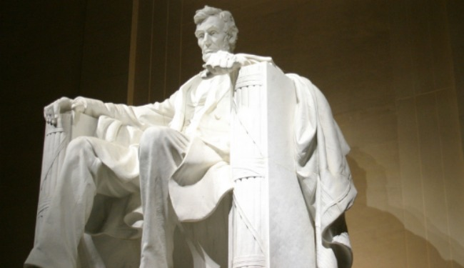
Studying for Tests and Quizzes
Students will have EVERYTHING they need to help them do well on tests and quizzes.
I give study guides for all tests (I DO NOT collect them)
For quizzes I always have them write down exactly what material the quiz covers.
They should study all notes (In Journal), review questions (In Journal), and worksheets.

Slide 46
Simulations
This is where the students get to experience history.
Simulations include:
Historical Debates (8th)
Code Talkers Challenge (8th)
Race to Space (8th)
McCarthyism Communist Hunt (8th)
WDSTF Museum (8th)
Geography Simulation (7th)
Welcome to Ellis Island! (7th)
Assembly Line Simulation (7th)
Welcome to the Working World! (7th)
Voting 2018 Simulation (7th and 8th)

Slide 47
Class Website!
I will post all downloadable forms as well as very short news updates on the team Weebly website.
All other information will come from my lesson plan emails!

Slide 48
7th and 8th Grade Misc. Info

Slide 49
http://valleyacademy78.weebly.com/
The 7th and 8th Grade Team Website

Slide 50
Tutoring – some times are By Appointment!!!
Mr. Hayo: Mon.- Fri. 7:20-8:00 a.m.
Ms. Brasher: Mon.- Fri. 7:30-8:00 a.m.
Mrs. Simon: Mon, Tues, Thurs. 7:30-8:00 a.m. (After school by apt.)
Mr. De La Cruz: Mon., Wed, Fri. 7:30-8:00 a.m.
(After school by apt.)

Slide 51
Weekly Emails
Please make sure you have signed up to receive our weekly emails.
This will help you keep your student organized and on top of all their work!
You should be getting 5 emails (one from each of us) and they include:
Homework for the week
When tests and quizzes are
When projects are handed out and when they are due

Slide 52
Family link
You can view your students grades online now!
New usernames and passwords went home yesterday.
Using our Family Link website you can track their grades.
If you have not signed up for this yet and would like to, contact one of us or email:
mwilliams@reidtraditional.com

Slide 53
Your Role in the 7th/8th Grade Life
Sometimes, these big kids still need your help and attention.
Go over the weekly emails with them
Check their grades frequently
Ask them about what they are learning
Help them stay organized and have good study habits

Slide 54
Emergency Lock Down
We are looking for donations for our lock down kits!
We need large Costco/Sam’s club size items
Please no drinks.
Things to include:
Granola Bars
Crackers
Nonperishable snacks

Slide 55
Dress Code
We know that as your students get older, they grow bigger and taller.
Please keep an eye out throughout the year to ensure their uniforms are up to Valley Academy standards
This includes: short pants and short skirts, tight pants or shirts
Please keep an eye out for girls nail polish and colored socks.
Jackets must be within Valley standards as well.

Slide 56
Any Questions? ☺

