Slide 1
7th and 8th Grade Curriculum Night
Welcome!
Please sign in!!! – Located at Coyote Club Desk
*The information in this PowerPoint is as of 8/15/2019 and is subject to change at any time at the teacher’s discretion*

Slide 2
Please sign in!!!
Let us know you came to see us ☺

Slide 3
7th and 8th Grade Math
Mr. Hayo

Slide 4
7th Grade Math
Textbook: Saxon Math: Course 3 (2007)
Other source material will supplement the text.
This is a review of arithmetic and a very good introduction to the foundations of algebra.
Much emphasis is placed on the mastery of decimals, fractions, per cents, one and two-step equations, exponents, graphing linear functions, the Pythagorean Theorem, proportional thinking, and, of course, mastering word problems.
Students who excel in this class will qualify for Math 8 Honors in the 8th grade.

Slide 5
Math 8 & 8H: Algebra Foundations
Textbook: All 8th graders will be using the Saxon Algebra 1 (2009) textbook. Because of the changes in the Arizona Standards, many topics from Algebra are incorporated into the state tests. This book will serve as the basic text. In addition, we will use supplementary materials to explore and expand mastery of Arizona State Standards and prepare student.
Students will explore concepts in: integer operations, functions, probability, special right triangles, linear graphing and equations of lines, inequalities, scientific notation, word problems, and many other math concepts. Other topics from algebra include simultaneous equations, and finding midpoints and distances given two points.
Students who demonstrate excellent mastery of the topics may be recommended for placement in an Algebra Honors class in high school.

Slide 6
Grading
10% -Homework
40% - Skills Test
40% - Saxon Tests
10% - Notebook
Portfolio: students will maintain a math 3-ring binder this year. They will save examples of their work, including: activities, homework, outlines, quizzes, and tests. When they register for high school, they should take the binder with them to show what they have accomplished and the quality of work they do.

Slide 7
Attention Parents!
Neatness, Organization and following directions are important.
Please check student work on a regular basis and emphasize quality.
It is a good practice for you to check their homework, tests and vocabulary.
Help them see math in the real world: shopping, paying bill, taxes, tipping, interest rates, etc.

Slide 8
More Info
During the school year, students will have the opportunity to complete a number of activities and tasks to improve their “understanding” of math concepts.

Slide 9
If a student needs help…
It is important that the parent, student, and teacher work together for success.
Please check homework, tests grades, etc.
If your child is having difficulty, please contact me as soon as possible
The earlier we define a weakness, the better chance we have to correct it.
Math Resources: Khan Academy.org., IXL through school

Slide 10
2019-2020 MMXIX-MMXX
It is going to be a great – fun – year in Math!!

Slide 11
7th and 8th Grade Literature
Mr. De La Cruz

Slide 12
Curriculum
7th Grade: The Elements of Literature, First Course, by HRW.
Roll of Thunder, Hear My Cry, The Giver, A Christmas Carol, Nothing But the Truth, The Hobbit, TBA
8th Grade: The Elements of Literature, Second Course, by HRW.
The Outsiders, To Kill a Mockingbird, Twelfth Night, Animal Farm, The Diary of Anne Frank

Slide 13
Grading Policy
Essays/Projects/Presentations – 40%
Quizzes – 30%
Homework – 30%
Following directions!

Slide 14
Homework/Late Work
We will be having homework regularly. I do not accept late work or incomplete work.

Slide 15
Regular Assignments
Vocabulary (High frequency/SAT type words)
1 new word every day
A quiz will be given every Friday
Units contain 20 words, so quizzes are cumulative until we reach 20. Then it starts over again.
Vocabulary Bell Work is checked and counted for a grade. Students are still responsible for completing vocabulary when they are absent.

Slide 16
Regular Assignments
Poem Memorization
One poem a month (list posted on Weebly). First recitation is September 6. Students must have accompanying paperwork.

Slide 17
Class Website!
I will post all downloadable forms on our Weebly page.
All other information will come from my lesson plan emails!

Slide 18
7th & 8th Grade Writing
Mrs. Rohr

Slide 19
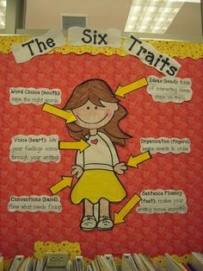
6+ 1 Traits of Writing & The Writing Process
6 +1 Traits
Ideas and Content
Organization
Conventions
Voice
Sentence Fluency
Word Choice
Presentation
Writing Process

Slide 20
Types of Essays
Narrative- Tells a Story
Expository- Seeks to explain
Argumentative- Paired with the Debates
Research Paper- Use multiple outlets to look for research and put together a cohesive paper

Slide 21
Writing Curriculum by Quarter
Quarter 1: Informative Writing
Quarter 2: Argumentative Writing
Quarter 3: 7th grade Research Writing/8th grade Narrative Writing
Quarter 4: 7th Grade Narrative Writing/8th grade Research Writing

Slide 22
Book Reports
One book report a quarter. All book reports completed IN CLASS, using only the book. Book report books MUST come from an approved list. Book choices will be due at least 3 weeks ahead of when the book reports will be written in class.

Slide 23
Grading Policy
Essays – 35%
Quizzes – 30%
Homework – 20%
Classwork 15%
Following directions!

Slide 24
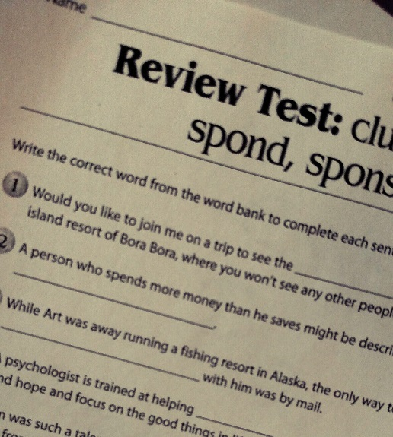
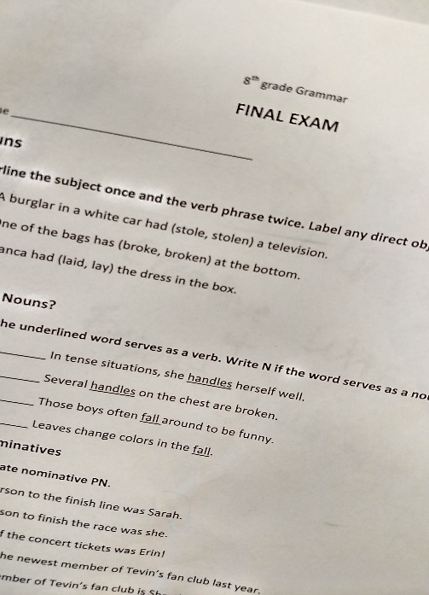
Quizzes and Essays
The kids will be notified well in advance.
Quizzes will cover mostly grammar.
Essays
Students will publish at least one essay a quarter. Final Draft will need to be typed unless otherwise noted.

Slide 25
Homework
Grammar worksheets- review of grammar concepts reviewed in class
*Diagramming will be given when the time is right
Writing- class time will be given to work on essays but some work will need to be done at home especially in quarter 3 and 4.

Slide 26
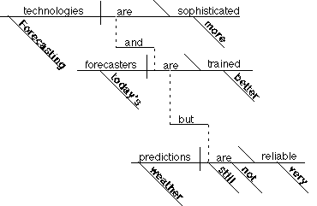
Why diagram sentences?
Sets structure
Analyzes
Synthesizes
Compare/contrast
Identify parts-of-speech
Self editing skills
Critical thinking skills

Slide 27
7th and 8th Grade Social Studies
Mrs. Simon

Slide 28
Grading
Homework/Practice
Classwork/Journal
Quizzes/Tests
Projects/Current Events
20%
15%
35%
30%

Slide 29
7th Grade Curriculum
First Quarter:
US & World Geography
Physical Geography
Second Quarter:
Civil War
Reconstruction
Third Quarter:
Gilded Age
1st and 2nd Industrial Revolution
Immigration
Progressive Movement
Imperialism
WWI
Fourth Quarter:
1920’s
Great Depression
Economics
Personal Finance

Slide 30
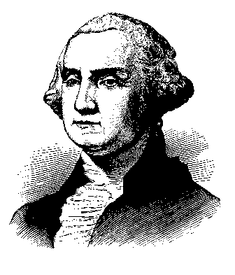
8th Grade Curriculum
First Quarter:
American Revolution
Birth of a New Nation
Government
Second Quarter:
3 Branches of Gov. study
Constitution Test
Third Quarter:
WWII
Holocaust
Cold War
Korean War
Fourth Quarter:
Vietnam
Civil Rights Movement
1960’s – 2000’s
Kennedy – Obama
“We Didn’t Start the Fire”
WDSTF Museum

Slide 31
Content is taught using Reading and Writing
Reading Comprehension
Writing
Students must be able to show where they found their answer in the texts (provide evidence)
They do this by highlighting where they found it or giving the page and paragraph number.
All students must restate their answers in complete sentences.
Every exam has at least 3 short essay responses, most quizzes will too.

Slide 32
Assignments
We DO NOT accept late work.
Homework:
These are normally worksheets we start in class and are finished at home
Quizzes
Multiple choice/Matching
Short Essay Answer
Projects:
Timelines (2 a year)
Presentations
Current Events
Exams
Multiple Choice/Matching
True/False
At least 3 short essays

Slide 33
Class activities
We will read from the text book and I will lecture which helps prepare for high school and beyond.
Students will analyze primary documents
We will analyze poems, writings, cartoons, and pictures etc.
We will watch historical videos (mostly from the History Channel and Discovery Education) that show actual footage of the historical events
We will also analyze music from certain time periods.
We will do historical simulations

Slide 34
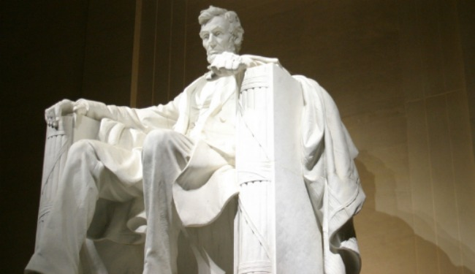
Studying for Tests and Quizzes
Students will have EVERYTHING they need to help them do well on tests and quizzes.
I give study guides for all tests (I DO NOT collect them)
For quizzes I always have them write down exactly what material the quiz covers.
They should study all notes (In Journal), review questions (In Journal), and worksheets.

Slide 35
Simulations
This is where the students get to experience history.
Simulations include:
Historical Debates (8th)
Code Talkers Challenge (8th)
Race to Space (8th)
McCarthyism Communist Hunt (8th)
WDSTF Museum (8th)
Geography Simulation (7th)
Welcome to Ellis Island! (7th)
Assembly Line Simulation (7th)
Welcome to the Working World! (7th)
Voting 2018 Simulation (7th and 8th)

Slide 36
Class Website!
I will post all downloadable forms as well as very short news updates on the team Weebly website.
All other information will come from my lesson plan emails!

Slide 37
7th and 8th Grade Science
Ms. Brasher

Slide 38
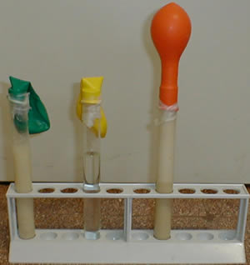
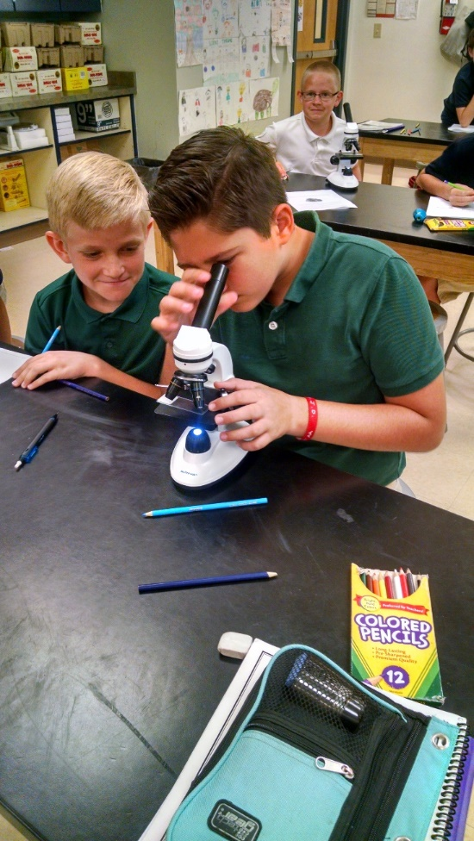
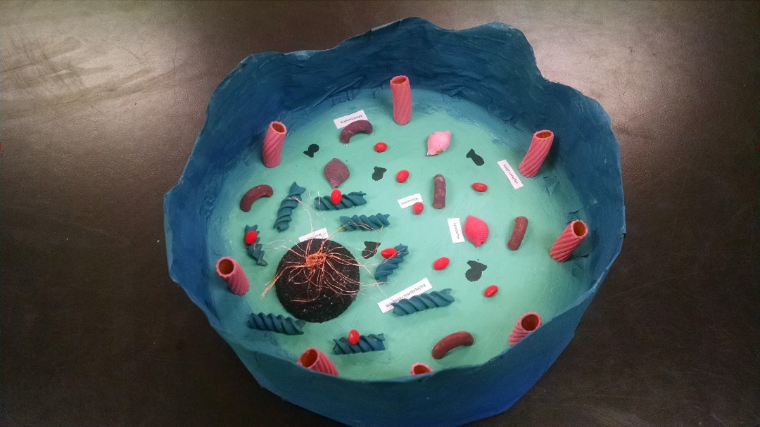
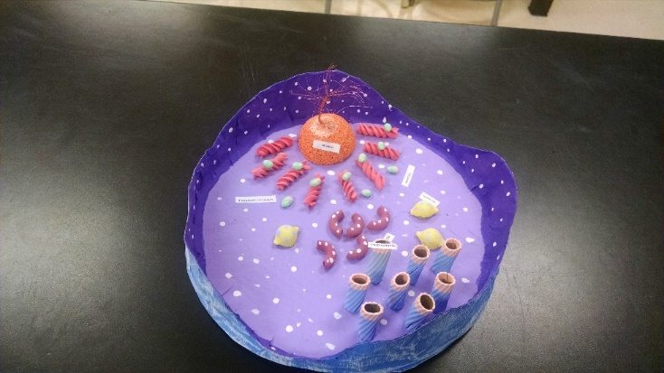
7th Grade—Life Science
Cell Biology
Life Science Introduction
Characteristics of Life
Spontaneous Generation
Cells
Eukaryotic Cells
Cells in Action

Slide 39
Labs and Activities

Slide 40
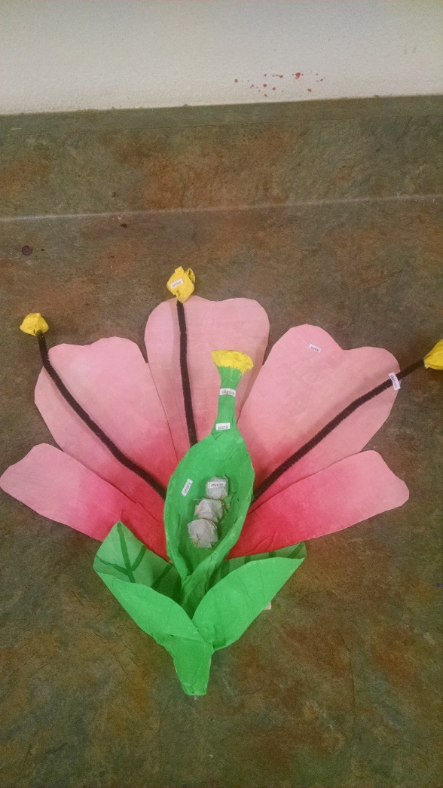
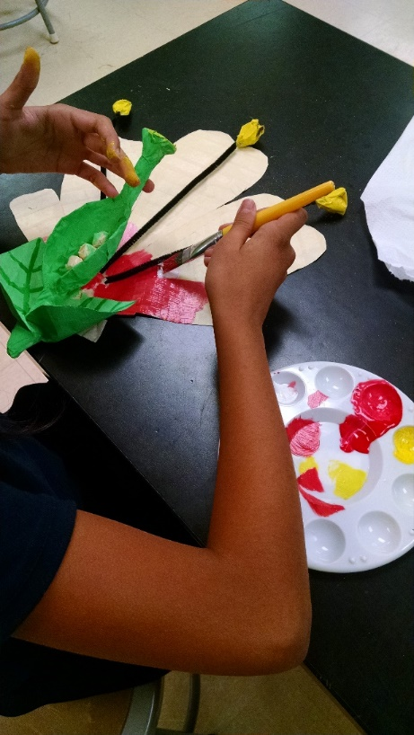
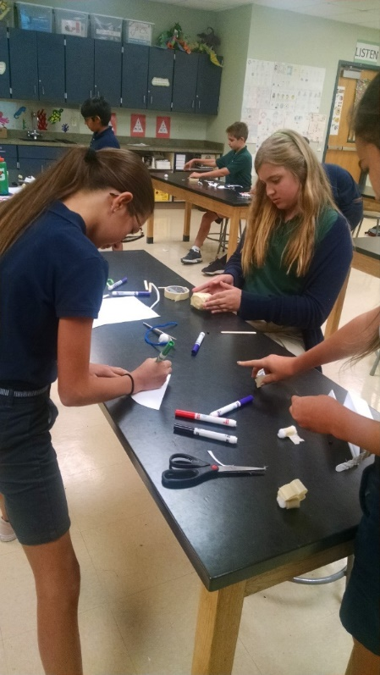
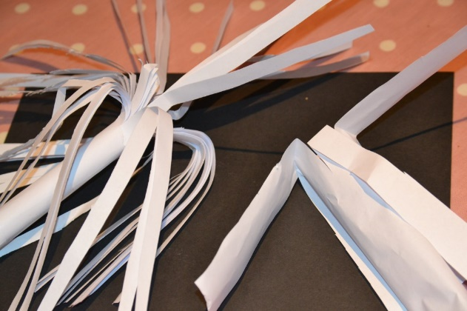
7th Grade—Life Science
Botany—Plants
Introduction to Plants
Seed Plants
Structures of Seed Plants
Plant Processes

Slide 41
Labs and Activities

Slide 42
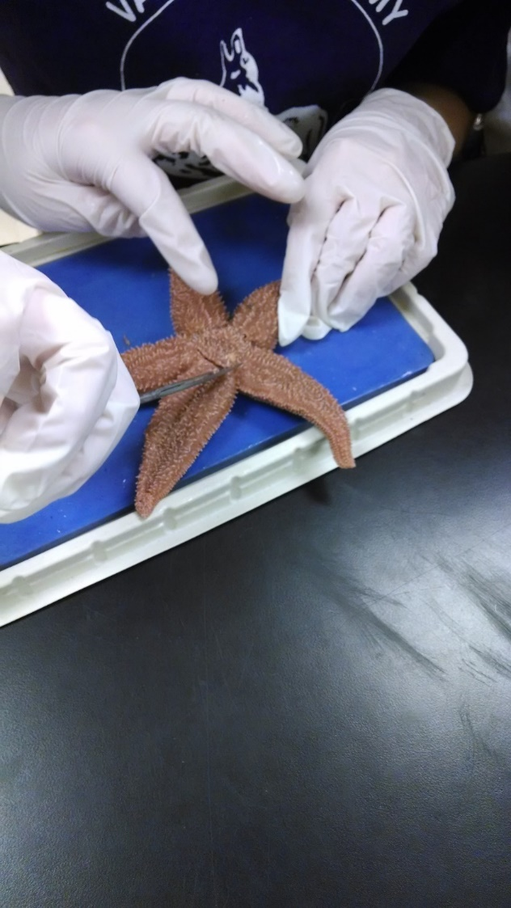
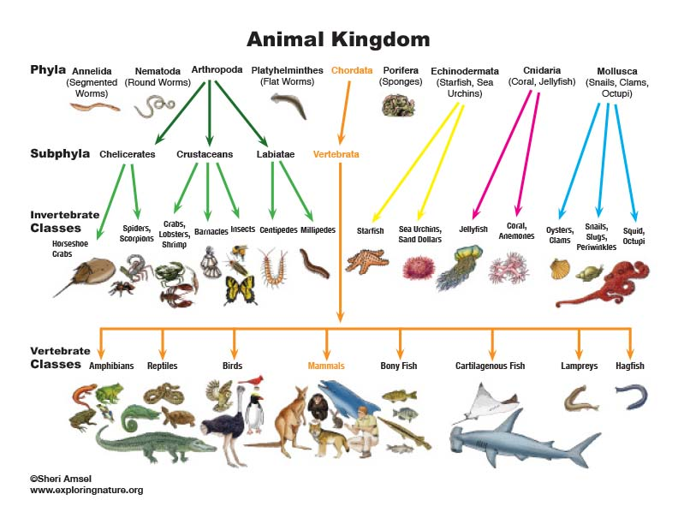
7th Grade—Life Science
Zoology
Classification
Porifera-Cnidaria
Flatworm
Round-Segmented Worm
Mollusks-Echinoderms
Chelicerates
Mandibulates
Insecta
Chordata
Chondrichthyes
Osteichthyes
Amphibia
Reptilia
Aves
Mammalia

Slide 43
Labs and Activities

Slide 44
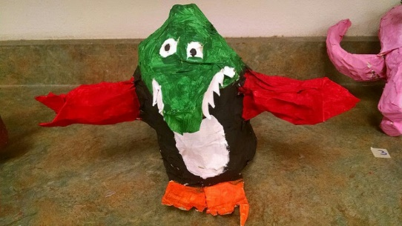
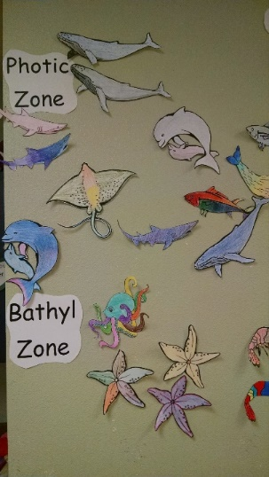
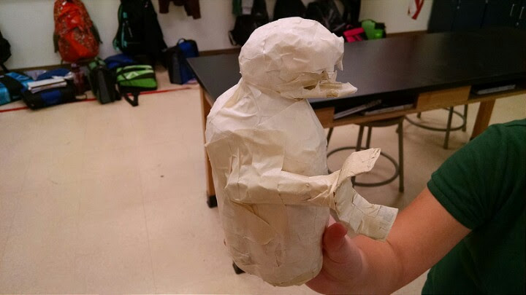
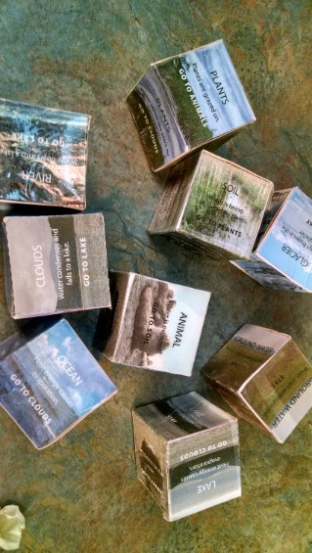
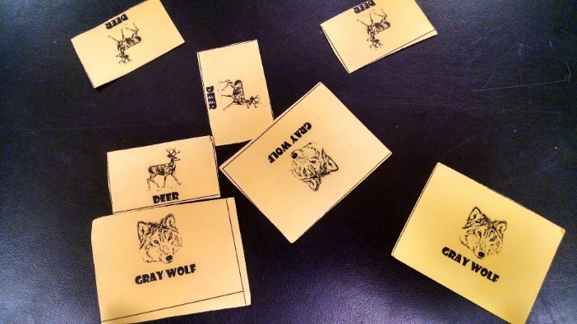
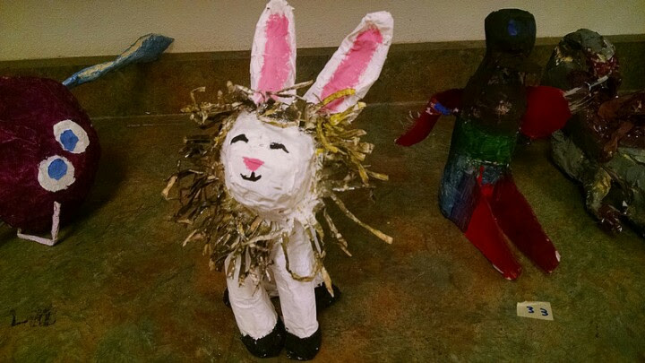
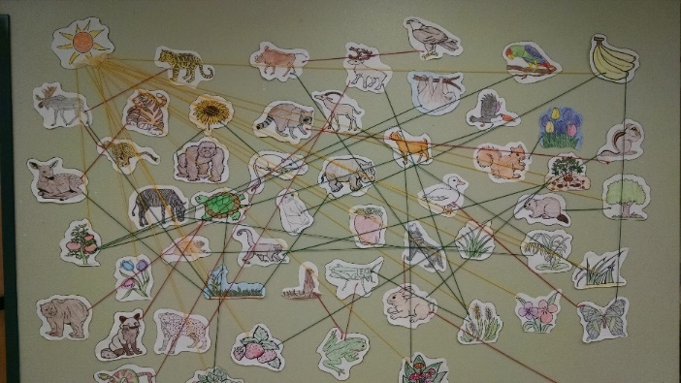
7th Grade—Life Science
Ecology
Biomes
Aquatic Biomes
Ecosystems
Animal Adaptations
Cycles
Populations

Slide 45
Labs and Activities

Slide 46
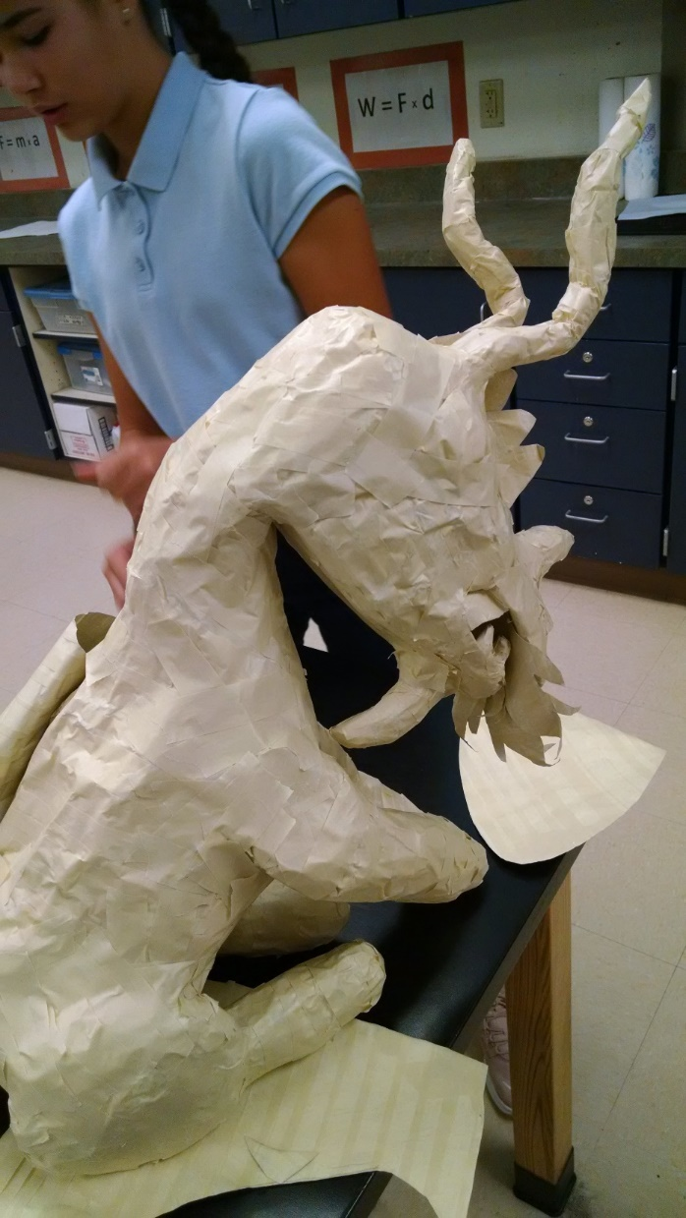
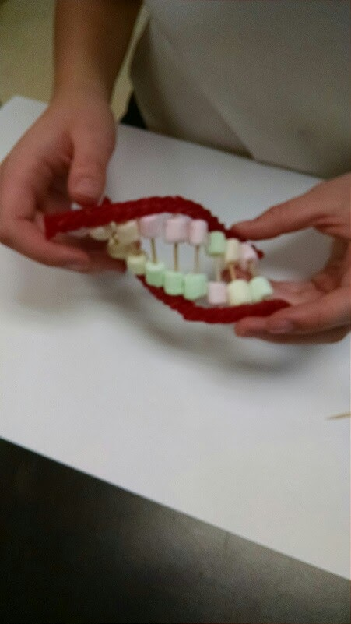
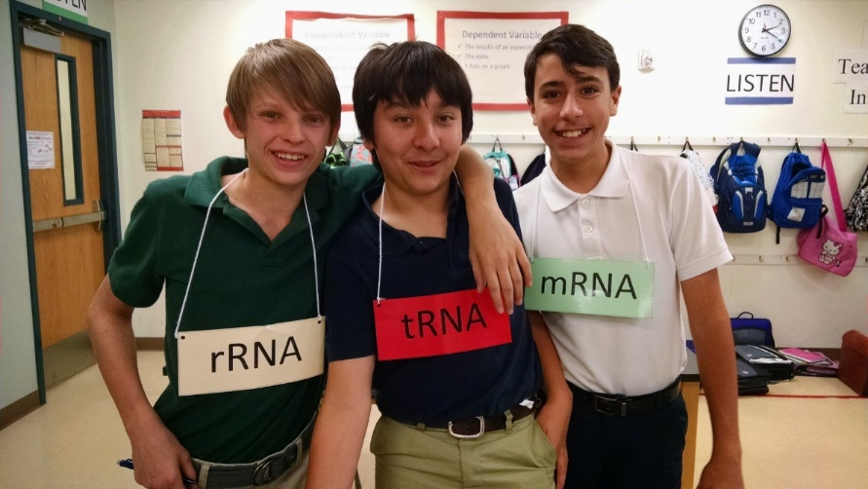
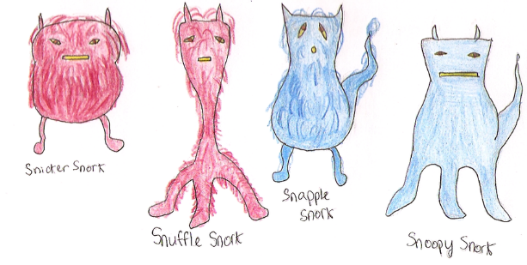
7th Grade—Life Science
Genetics
Mendel
Meiosis
DNA and Genes
How DNA Works

Slide 47
Labs and Activities

Slide 48
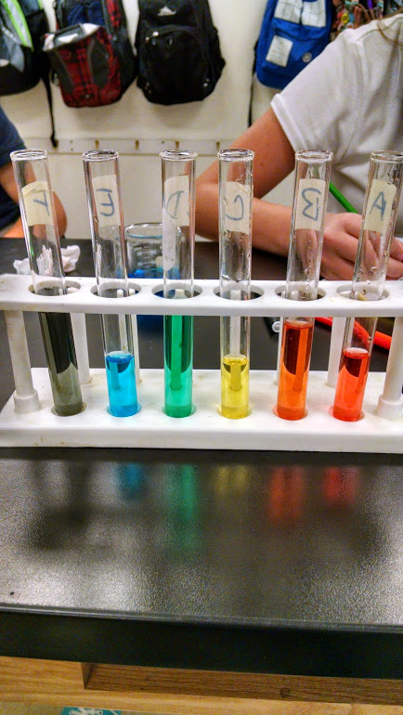
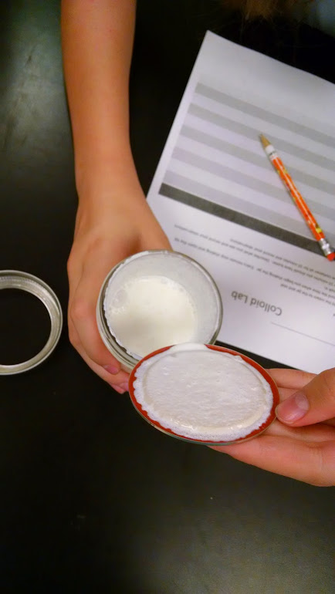
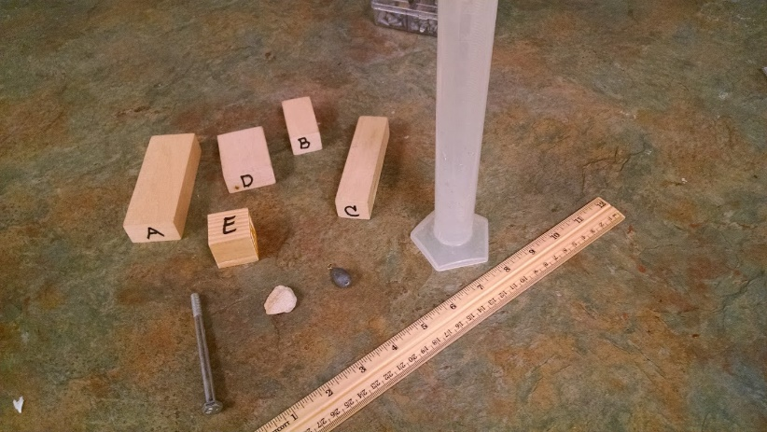
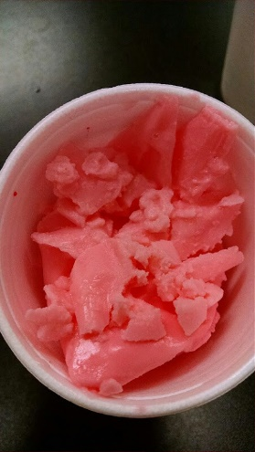
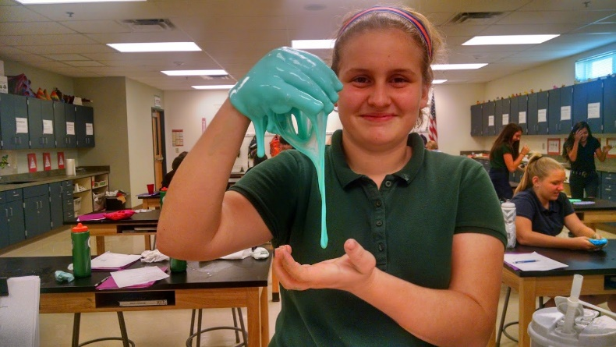
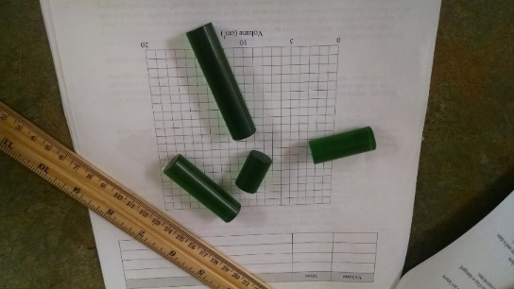
8th Grade—Physical Science
Matter
Properties of Matter
States of Matter
Changes of State
Elements, Compounds and Mixtures

Slide 49
Labs and Activities

Slide 50
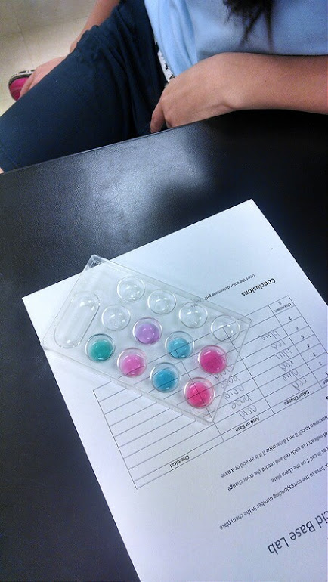
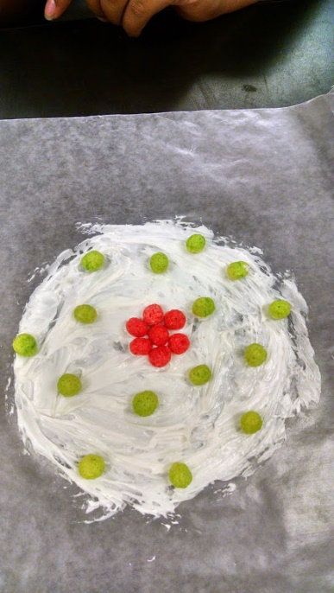
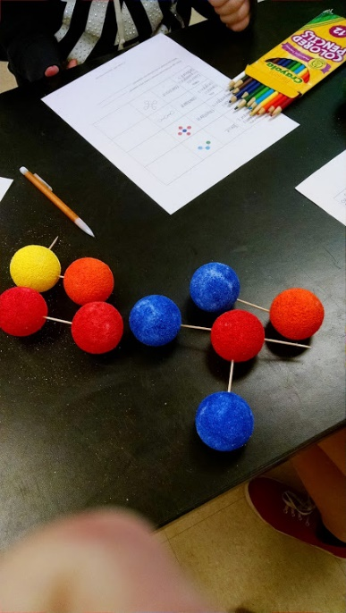
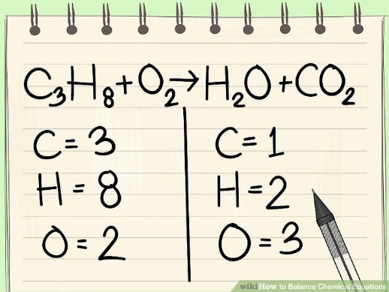
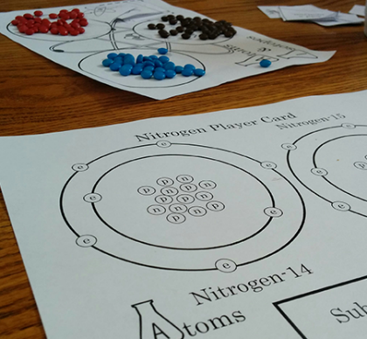
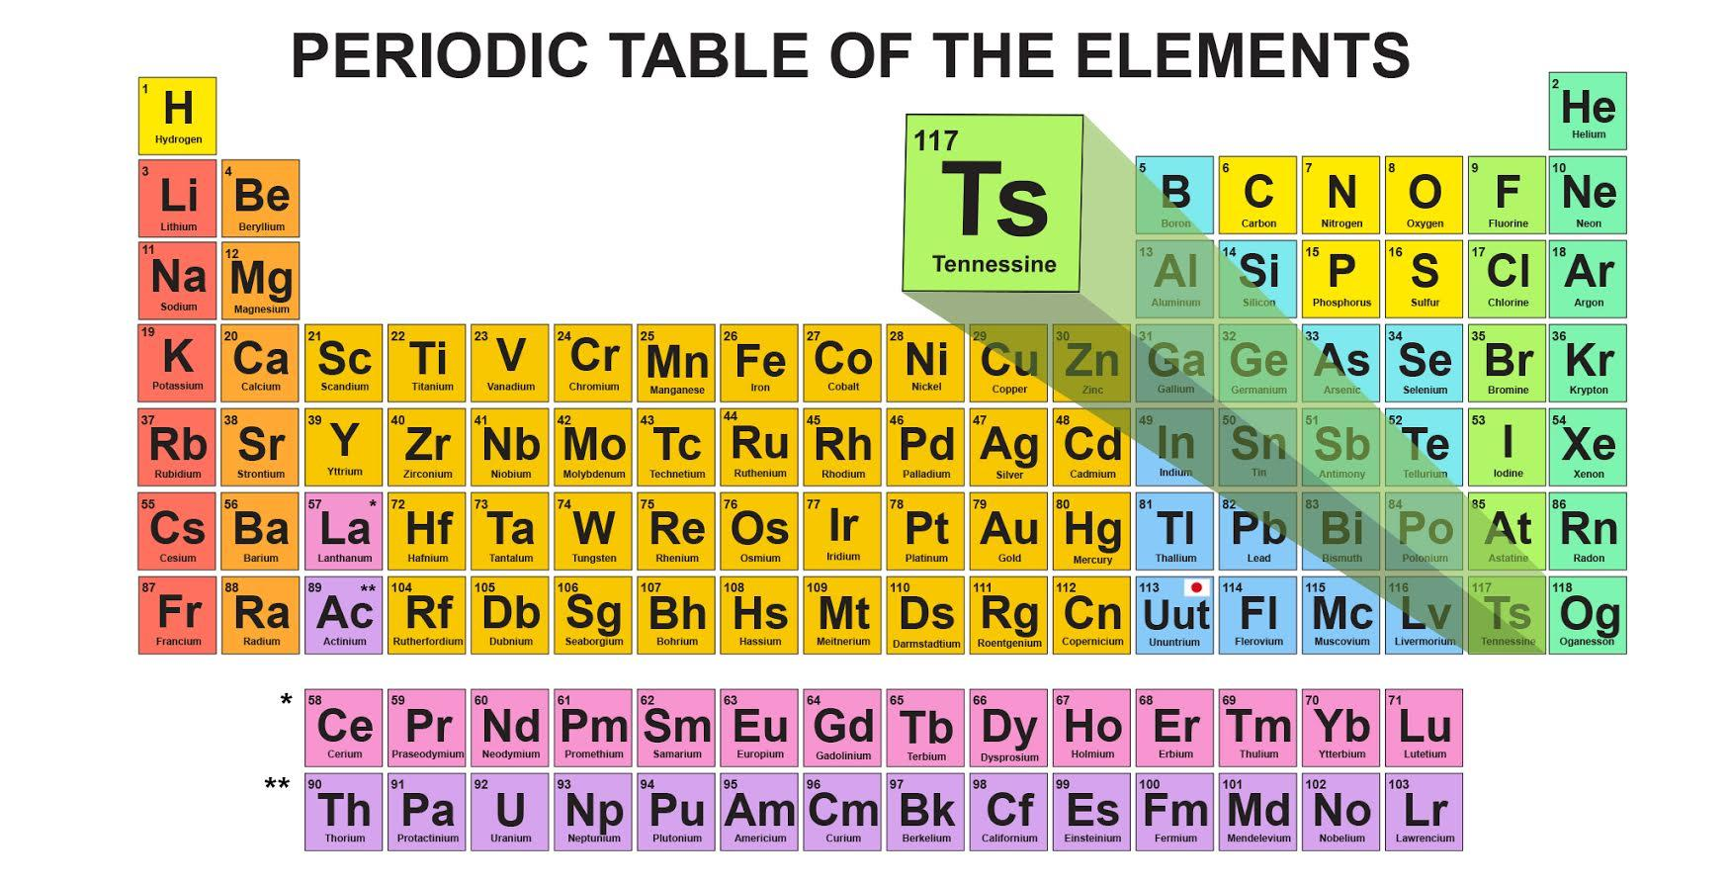
8th Grade—Physical Science
Atoms/Periodic Table
Atoms
History of Atoms
Periodic Table
Chemical Bonding
Chemical Reactions
Chemical Compounds

Slide 51
Labs and Activities

Slide 52
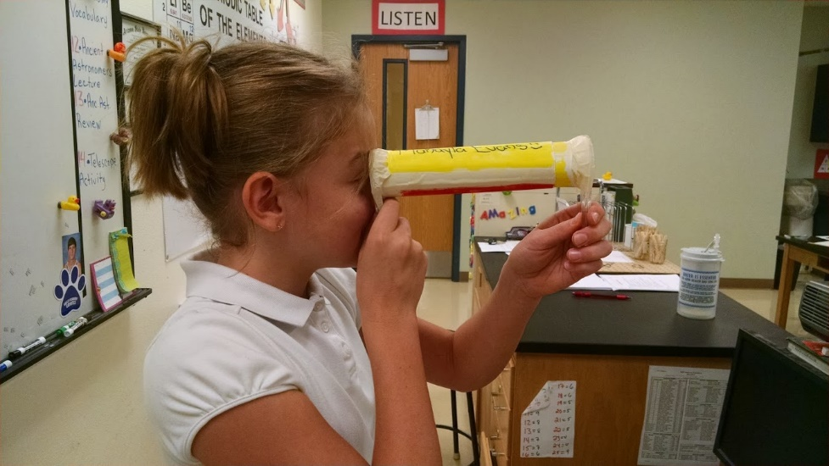
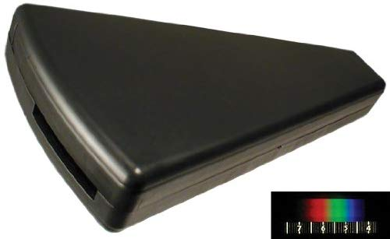
8th Grade—Physical Science
Astronomy
Solar System
Planets
Objects in the Solar System
Stars

Slide 53
Labs and Activities

Slide 54
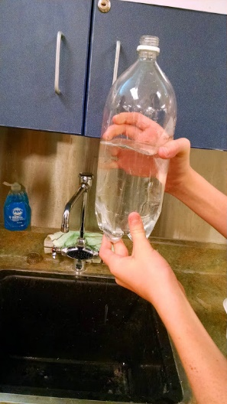
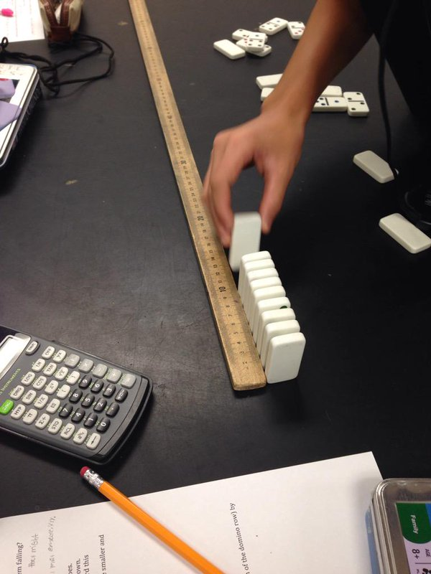
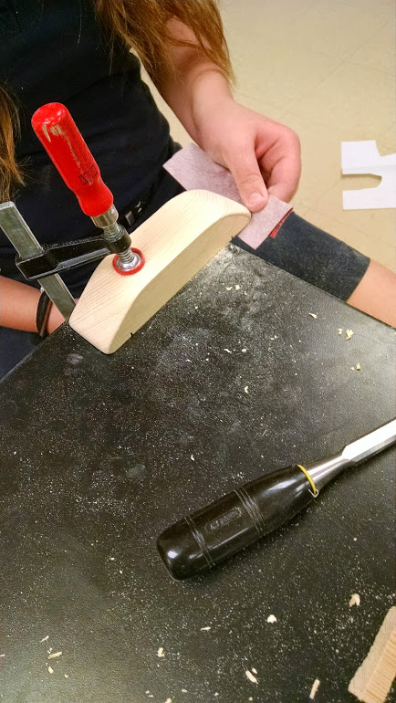
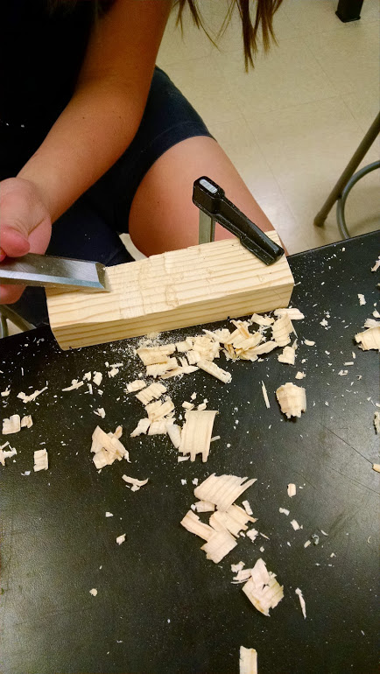
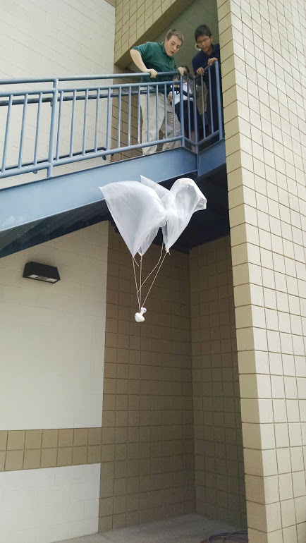
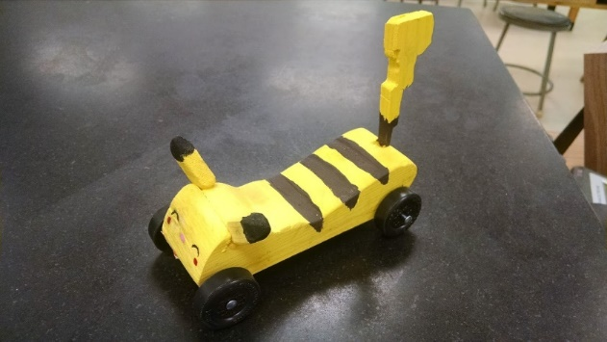
8th Grade—Physical Science
Physics/Newton’s Laws
Speed, Velocity, Acceleration
Forces and Friction
Gravity in Motion
Newton’s Laws
Fluids and Pressure
Floating and Flying
Work and Power
Machines

Slide 55
Labs and Activities

Slide 56
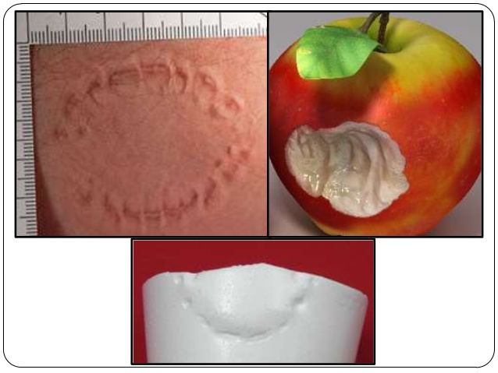
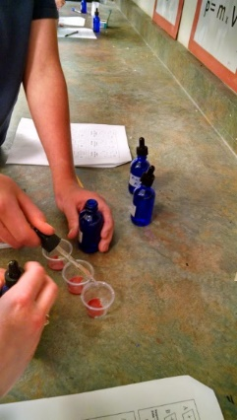
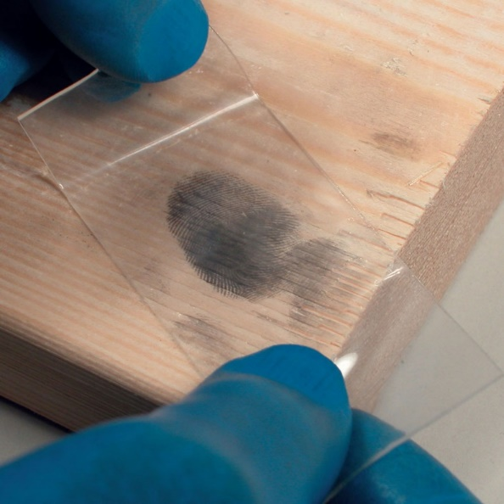
8th Grade—Physical Science
Forensics
Crime Scene Basics
Physical Evidence
Fingerprints
Impression Evidence
Hair and Fiber Evidence
Blood Evidence
DNA and Chromatography
Forensic Entomology
Forensic Anthropology
Arson

Slide 57
Labs and Activities

Slide 58
How will they learn?
Hands-on labs and activities with every lesson
Lecture
Lecture notes already done.
They get to hear and see the concepts.
Practice
6 assignments each week
All assignments in one “Practice” packet.
Packets should be done in order (simple to complex).
2 hours of class time to complete.
PERFECT PRACTICE MAKES PERFECT

Slide 59
How will they learn?
Practice graded and returned the next day.
Hundreds club for students with 700 out of 700 points.
Quizzes weekly.
Exam at the end of the unit.
Practice/Labs 50%
Quiz 20%
Exam 30%

Slide 60
I give over 35,000 points each year.
That means students can make mistakes and still recover.
Not doing an assignment will be very bad.
The only students who fail, fail because the don’t complete the practice.
The lessons build confidence.
Students strive for perfection.
They see that the hard work pays off.

Slide 61
Ending Year Average Both Grades
7th Grade 92% (median 94%)
8th Grade 91% (median 92%)
It is not easy.
They have to do a lot of work. But it is accessible to all students.

Slide 62
Science AIMS Scores
Average 93% Pass
60% Exceeds

Slide 63
7th and 8th Grade Misc. Info

Slide 64
http://valleyacademy78.weebly.com/
The 7th and 8th Grade Team Website

Slide 65
Tutoring – some times are By Appointment!!!
Mr. Hayo: Mon, Wed-Fri 7:20-7:45 a.m.
Ms. Brasher: Mon, Wed-Fri. 7:30-8:00 a.m.
Mrs. Simon: Mon-Fri. 7:30-8:00 a.m. (After school by apt.)
Mrs. Rohr: Mon.- Fri. 7:30-8:00 a.m.
Mr. De La Cruz: Mon., Wed, Fri. 7:30-8:00 a.m.
(After school by apt.)

Slide 66
Weekly Emails
This will help you keep your student organized and on top of all their work!
You should be getting 5 emails (one from each of us) and they include:
Homework for the week
When tests and quizzes are
When projects are handed out and when they are due

Slide 67
Parent Portal
You can view your students grades online now!
New usernames and passwords went home through email.
Using our Parent Portal website you can track their grades.
PROGRESS REPORTS WILL ONLY BE AVAILABLE ONLINE!
YOUR CHILD WILL GET CARD SIGNATURES IF NOT LOOKED AT ONLINE!
If you have not signed up for this yet and would like to, contact one of us or email:
mwilliams@reidtraditional.com

Slide 68
Your Role in the 7th/8th Grade Life
Sometimes, these big kids still need your help and attention.
Go over the weekly emails with them
Check their grades frequently
Ask them about what they are learning
Help them stay organized and have good study habits

Slide 69
Emergency Lock Down
We are looking for donations for our lock down kits!
We need large Costco/Sam’s club size items
Please no drinks.
Things to include:
Granola Bars
Crackers
Nonperishable snacks

Slide 70
Dress Code
We know that as your students get older, they grow bigger and taller.
Please keep an eye out throughout the year to ensure their uniforms are up to Valley Academy standards
This includes: short pants and short skirts, tight pants or shirts
Please keep an eye out for girls nail polish and colored socks.
Jackets must be within Valley standards as well.

Slide 71
Any Questions? ☺

