Slide 1
DNA
Evidence
How is DNA be used to solve crimes?
8th Grade Forensic Science
T. Trimpe http://sciencespot.net/

Slide 2
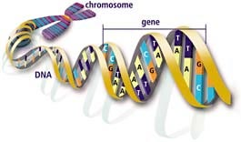
What is DNA?
DNA stands for deoxyribonucleic acid and contains genetic information. It is found on chromosomes located in the nucleus of our cells.
What makes up DNA?
The sides or backbone of the DNA molecule are made up of sugar (deoxyribose) and phosphate molecules.
The rungs that form the middle of the molecule are made up of pairs of nucleotides or nitrogen bases. Adenine (A) pairs with thymine (T), while guanine (G) always pairs with cytosine (C).
The order of the bases determines the genetic code.
Double Helix
DNA Image: http://science.howstuffworks.com/genetic-science/dna-evidence.htm

Slide 3
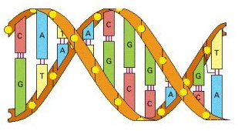
Label the DNA molecule shown below.
Word List:
Cytosine Adenine Thymine Guanine Backbone Nitrogen (N) Bonds
BACKBONE
CYTOSINE
THYMINE
GUANINE
N BONDS
ADENINE

Slide 4

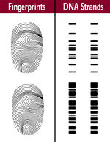
How is DNA used as evidence?
Each person’s DNA is different from other people (except identical twins).
DNA collected from a crime scene can either link a suspect to the evidence or eliminate a suspect, similar to the use of fingerprints.
DNA can identify a victim through DNA from relatives, even when no body can be found.
DNA can link crime scenes together by linking the same perpetrator to different scenes locally, statewide, and across the nation.
DNA can place an individual at a crime scene, in a home, or in a room where the suspect claimed not to have been.
DNA can refute a claim of self-defense and put a weapon in the suspect's hand.
It can change a story from an alibi to one of consent.
DNA Strand Image & information : http://www.dna.gov/audiences/investigators/know/

Slide 5
What factors affect DNA evidence?
Several factors can affect the DNA left at a crime scene, such as environmental factors (e.g., heat, sunlight, moisture, bacteria, and mold). Therefore, not all DNA evidence will result in a usable DNA profile. Further, DNA testing cannot identify when the suspect was at the crime scene or for how long.
What is CODIS?
CODIS stands for COmbined DNA Index System, which is an electronic database of DNA profiles that can identify suspects. DNA profiles from individuals convicted of certain crimes, such as rape, murder, and child abuse, are entered into CODIS and help officers identify possible suspects when no prior suspect existed.
Did you know?
Each human cell contains three billion DNA base pairs. Our unique DNA amounts to 0.1% or 3 million base pairs.
DNA information : http://www.dna.gov/audiences/investigators/know/

Slide 6
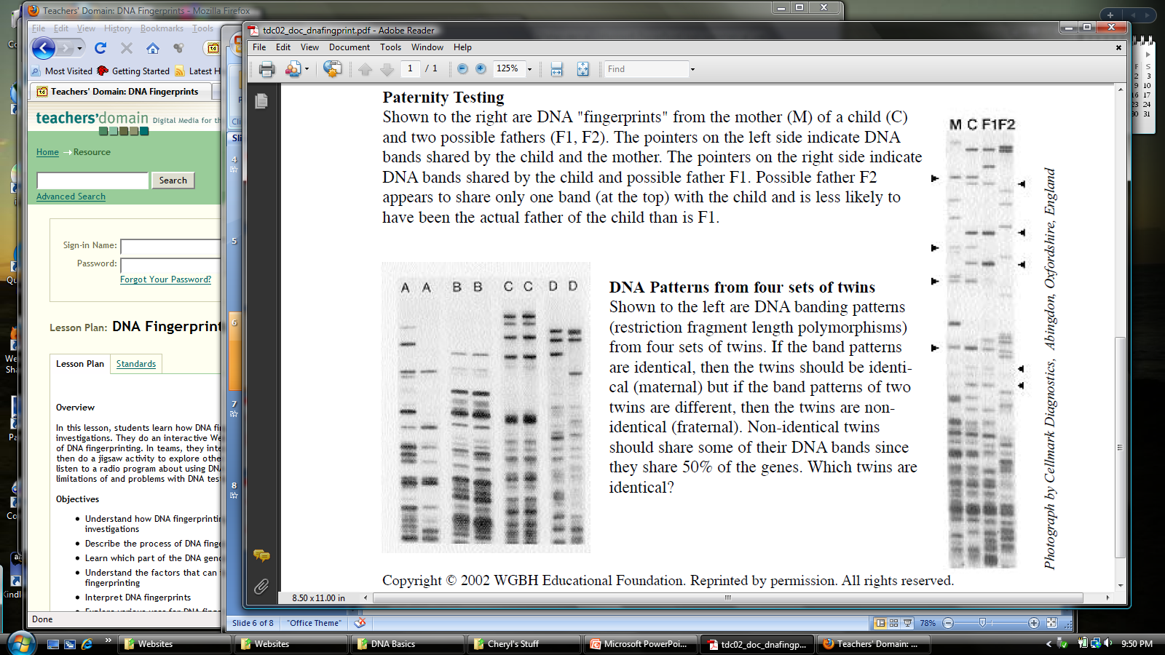
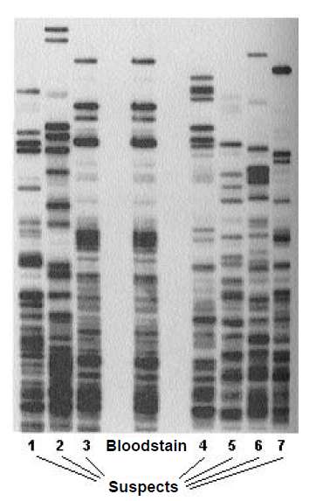
A. Who done it?
C. Identical or not?
Which sets of twins are identical twins?
B. Whose your daddy?
Which sample is most likely to be the father?
F1 or F2
Which suspect matches the bloodstain?
Information & image from http://www.teachersdomain.org/resource/tdc02.sci.life.gen.lp_dnamysteries/

Slide 7

True or False?
Which three statements below are true?
1. The DNA in a man's blood is the same as the DNA in his skin cells and saliva.
2. Each person's DNA is different from every other individual's.
3. DNA can be found in all the cells in our bodies except the blood cells.
4. DNA can have forensic value even if it is decades old.
5. DNA evidence was first used to get a conviction in a trial in 1987.
Watch the video segment from NOVA: "The Killer's Trail" and be ready to answer the questions on the next slide.
Video available at http://www.teachersdomain.org/resource/tdc02.sci.life.gen.sheppard/
More information available at http://www.pbs.org/wgbh/nova/sheppard/

Slide 8
Chromatography
Applications in Forensic Science
T. Trimpe 2006 http://sciencespot.net/

Slide 9
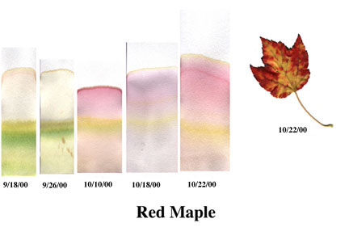
What is chromatography?
From Wikipedia ...
Chromatography (from Greek word for chromos for colour) is the collective term for a family of laboratory techniques for the separation of mixtures. It involves passing a mixture which contains the analyte through a stationary phase, which separates it from other molecules in the mixture and allows it to be isolated.
Which means ...
Chromatography is the physical separation of a mixture into its individual components.
We can use chromatography to separate the components of inks and dyes, such as those found in pens, markers, clothing, and even candy shells. Chromatography can also be used to separate the colored pigments in plants or used to determine the chemical composition of many substances.
http://members.shaw.ca/vict/chemistry_test3.htm

Slide 10
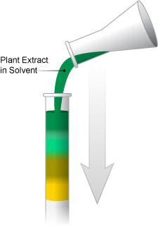
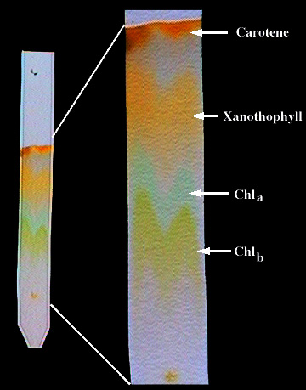
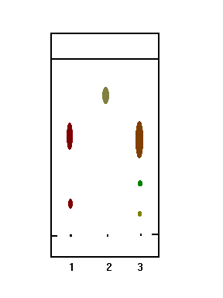
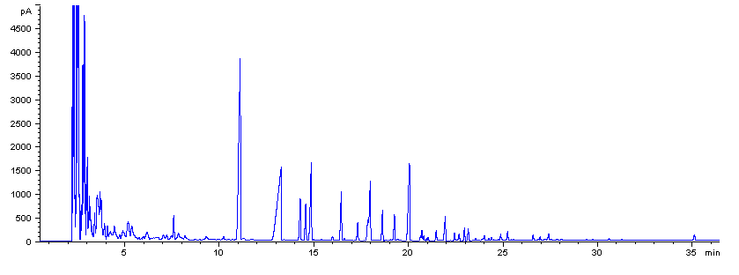
Examples of Chromatography
Liquid Chromatography
Used to identify unknown plant pigments & other compounds.
Thin-Layer Chromatography
Uses thin plastic or glass trays to identify the composition of pigments, chemicals, and other unknown substances.
Gas Chromatography
Used to determine the chemical composition of unknown substances, such as the different compounds in gasoline shown by each separate peak in the graph below.
Paper Chromatography
Can be used to separate the components of inks, dyes, plant compounds (chlorophyll), make-up, and many other substances

Slide 11
Mixtures & Compounds
Mixture – Two or more substances that are mixed together, but not chemically combined.
Examples of mixtures ...
Air – mixture of gases
Bowl of cereal – mixture of cereal and milk
Soda pop – mixture of soda syrup, water, and CO2 gas
Fog –water suspended in air
Kool-Aid – mixture of water, sugar, and flavor crystals
Compounds – Two or more elements that are chemically combined.
Examples of compounds ...
Salt –Sodium and chlorine combined chemically
Water –Hydrogen and oxygen combined chemically
Carbon Dioxide – Carbon and oxygen combined chemically

Slide 12
Solutions
Solutions are mixtures in which one substance is dissolved in another.
Solutions have two parts: solute and solvent
The solute is the substance that is dissolved.
The solvent is the substance that does the dissolving
Identify the solute and solvent in each solution ...
Solution | Solute | Solvent
Lemonade
Soda pop
Ocean water
Solubility - A measure of how much of a given substance will dissolve in a liquid.
A substance that does not dissolve in water is called insoluble.
A substance that does dissolve in water is called soluble.

