Slide 1
terrestrial planets
prograde rotation
retrograde rotation
gas giants
Mercury
Venus
Earth
Mars
Jupiter
Saturn
Uranus
Neptune
Pluto

Slide 2
Planets

Slide 3
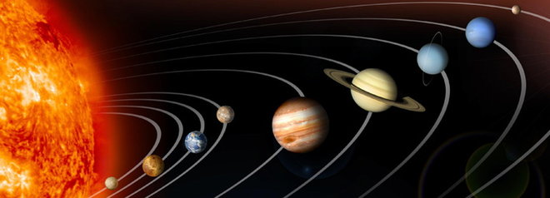
Inner Planets
The solar system is divided into two groups of planets—inner planets and outer planets.
The inner planets are called terrestrial planets, because they are small, dense and rocky.

Slide 4
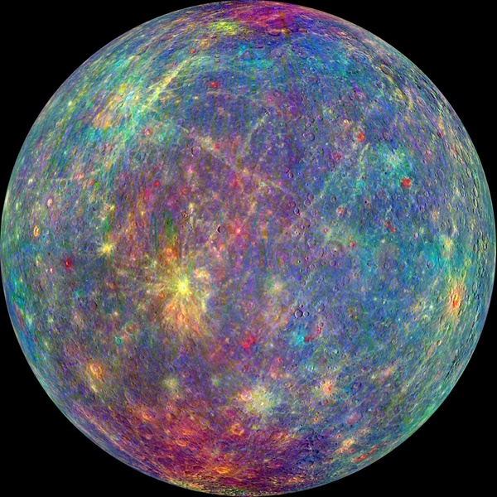
Mercury
On Mercury, you would weigh 38% of what you weigh on Earth.
A day on Mercury is 59 Earth days long.
Mercury spins on its axis much more slowly than Earth does.
Mercury’s year is only 88 Earth days long.
Mercury’s surface temperature ranges from -173C to 427 C.
Diameter 4,878 km

Slide 5
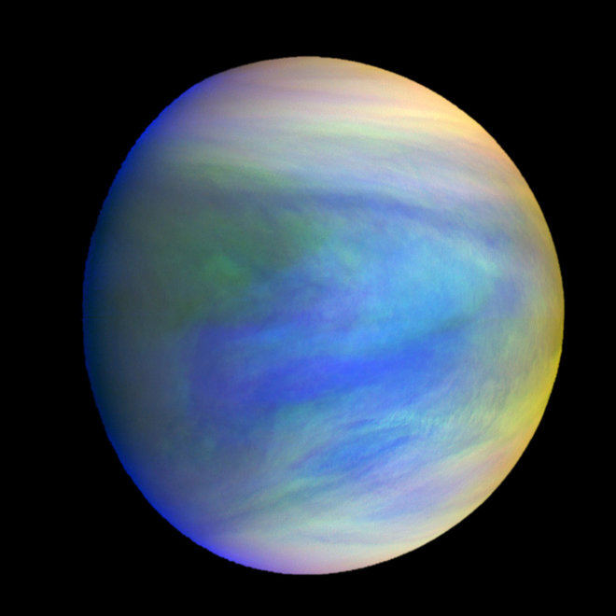
Venus
Venus is more similar to Earth than any other planet.
They have about the same size, mass and density.
Unlike Earth, the sun on Venus rises in the west and sets in the east.
This is because Venus rotates clockwise while all of the other planets rotate counter clockwise.

Slide 6
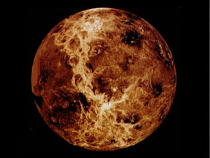
Venus
Earth is said to have prograde rotation.
Venus has retrograde rotation.
Venus rotates much more slowly than Earth.
A day on Venus takes 243 Earth days, while a year takes 224 Earth days.

Slide 7
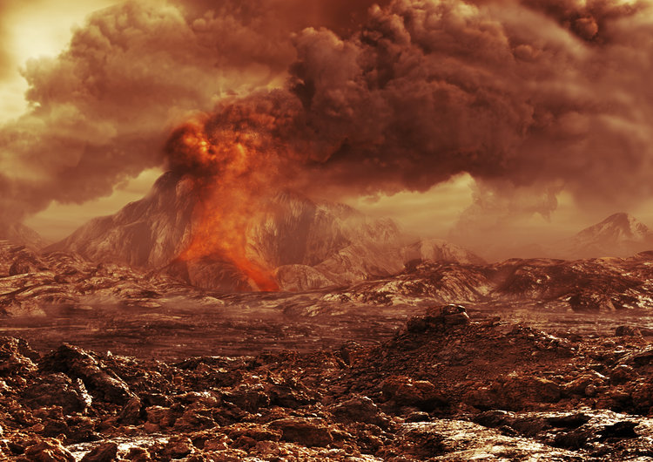
Venus
The atmosphere on Venus is the densest of the terrestrial planets.
It consists mostly of carbon dioxide and corrosive acids.
The carbon dioxide traps heat from sunlight in the process known as the greenhouse effect.
The surface temperature is 464 C.
Venus is the hottest planet.
Diameter 12,104 km

Slide 8
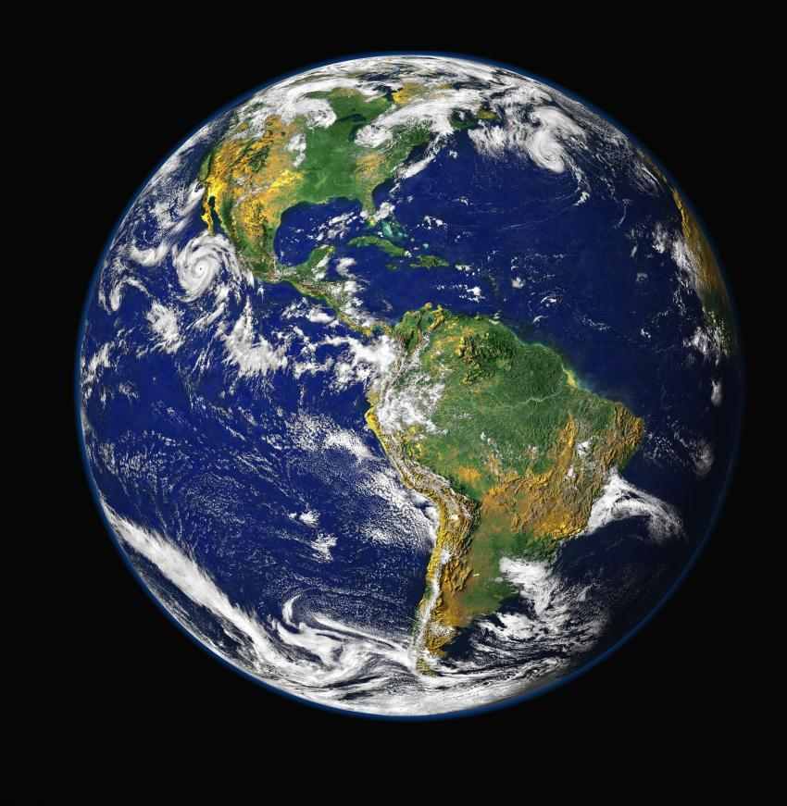
Earth
Constantly changing weather patterns create the swirls of clouds that blanket the Earth.
Earth formed at just the right distance from the sun.
The temperatures are warm enough to prevent most of its water from freezing, but cool enough to keep it from boiling away.

Slide 9
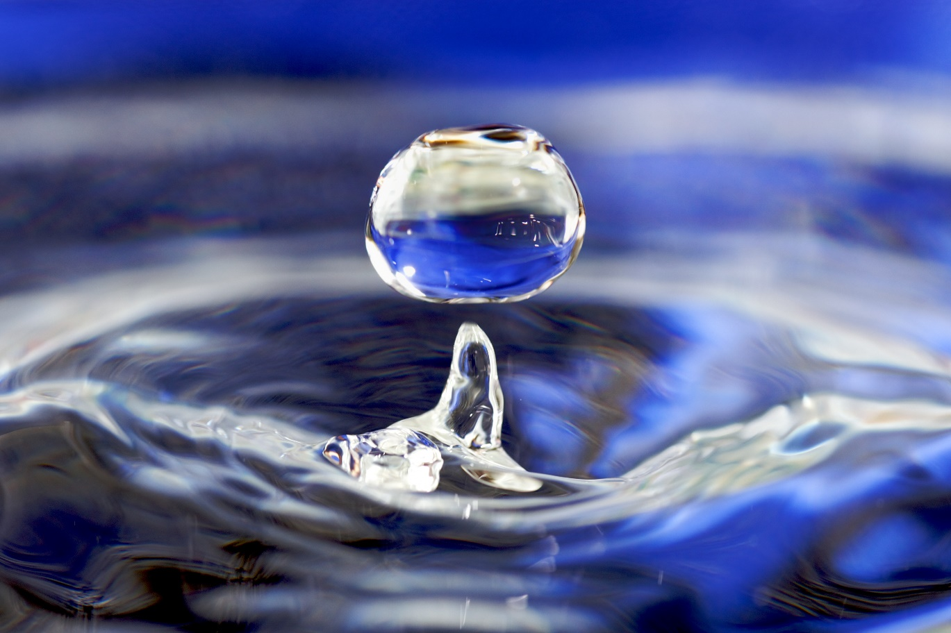
Earth
Liquid water is the key to the development of life on Earth.
Water provides a means for much of the chemistry that living things depend on for survival.
Diameter 12,756

Slide 10
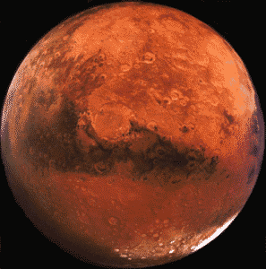
Mars
Because of its thin atmosphere, and its great distance from the sun, Mars is a cold planet.
Mid-summer temperatures range from -13 C to -77 C.
The atmosphere is so thin that the air pressure at the planet’s surface is equal to 30 km above Earth’s surface (about 3 times higher than most planes fly).

Slide 11
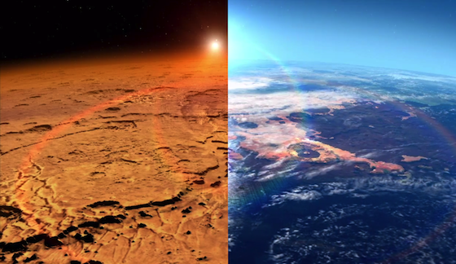
Mars
The pressure of Mars’s thin atmosphere is so low that any liquid water would quickly boil away.
The only water on Mars is in the form of ice.
Liquid water did exist on Mars at one time.
Most of that water is found in the polar ice caps or frozen beneath the surface.

Slide 12
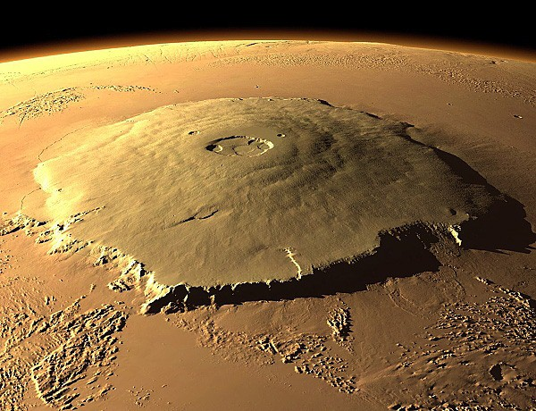
Mars
Mars has two volcanic fields.
The largest mountain in the solar system is the extinct volcano Olympus Mons.
Period of rotation 24 hours 37 minutes.
Period of revolution 1 year 322 days.
Diameter 6,794

Slide 13
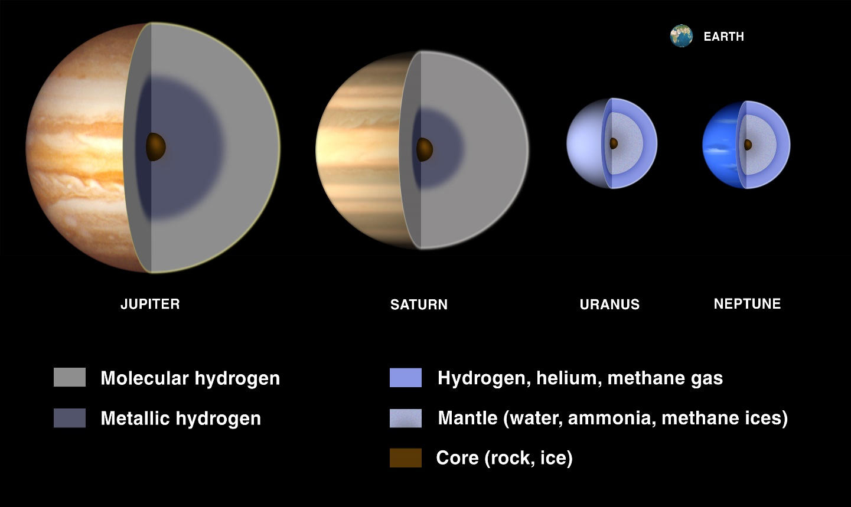
Outer Planets
All of the outer planets are gas giants.
Gas giants are large without solid surfaces.

Slide 14
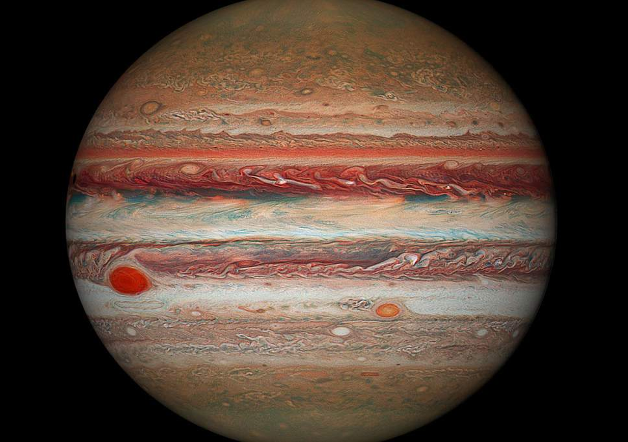
Jupiter
Like the sun, Jupiter is made of hydrogen and helium.
The outer part of Jupiter’s atmosphere is made of layered clouds of water, methane and ammonia.
Jupiter also has a great red spot, which is a long lasting storm system, which has a diameter one and a half times Earth.

Slide 15
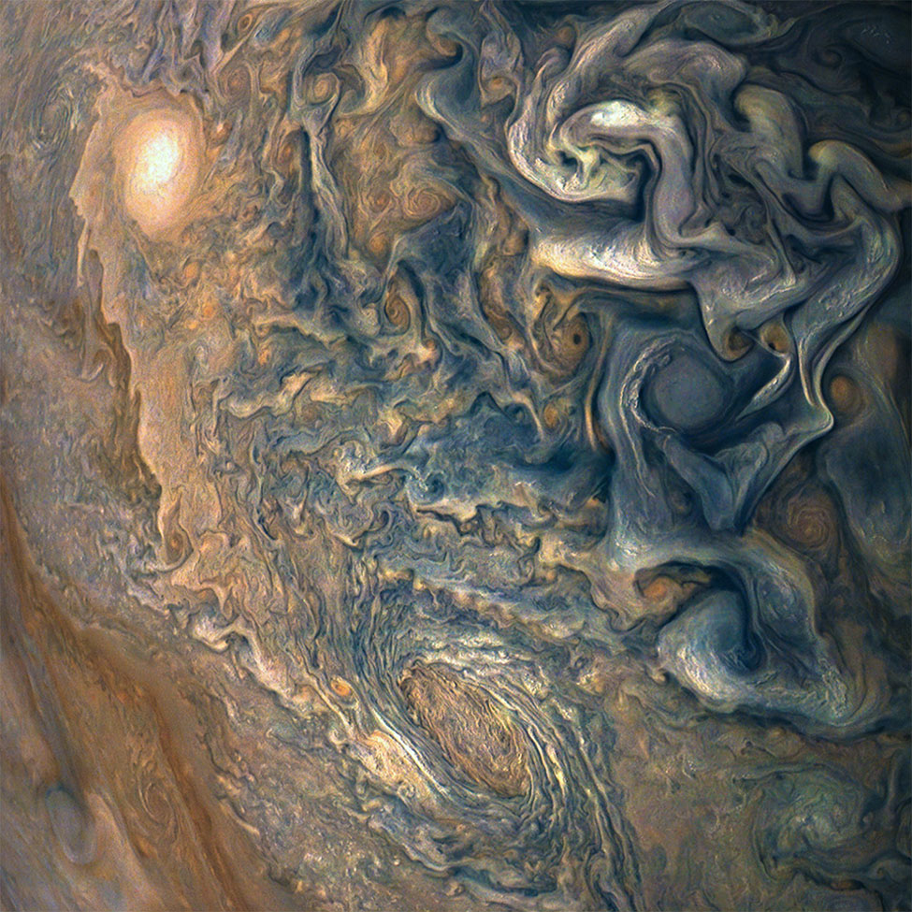
Jupiter
At 10,000 km deep, the pressure is high enough to change hydrogen gas into a liquid.
Unlike most planets, Jupiter radiates much more heat than it receives from the sun.
Period of rotation 9 hours 50 minutes.
Period of revolution 11 years 313 days.
Diameter 142,984 km

Slide 16
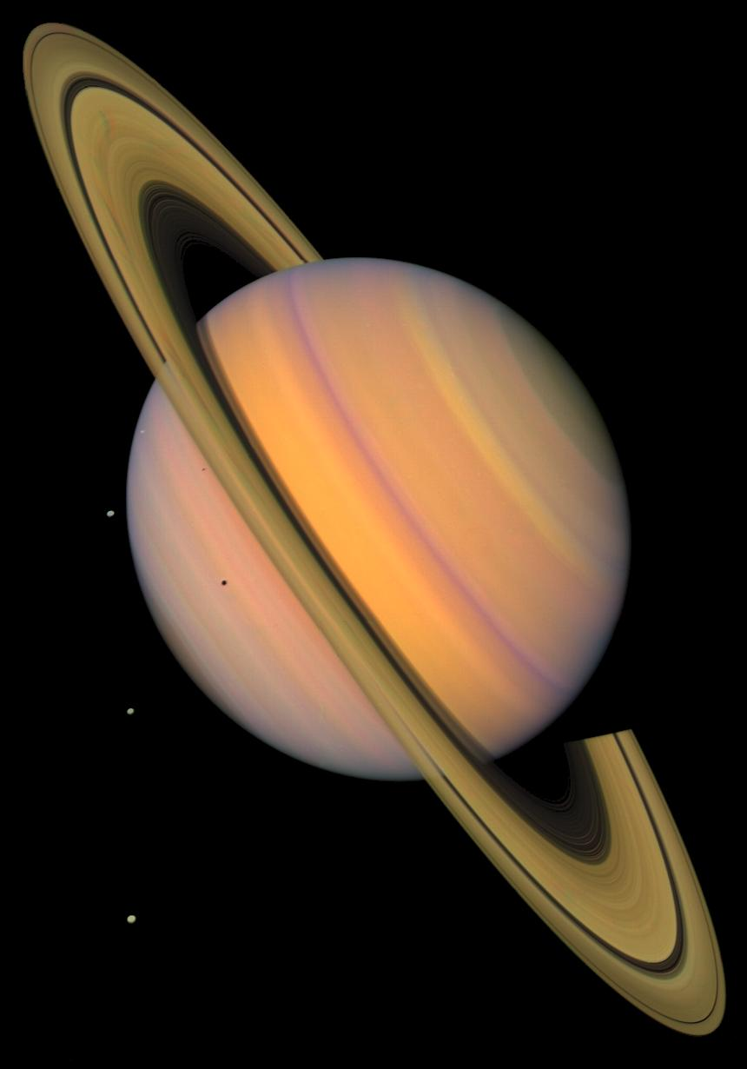
Saturn
Saturn is the second largest planet; it is 764 times the volume of Earth and 95 times more massive.
Its composition is mostly hydrogen and helium, with methane, ammonia and ethane in the upper atmosphere.
Saturn is not as colorful as Jupiter because it is cooler.
Like Jupiter, Saturn gives off more heat than it receives from the sun.

Slide 17
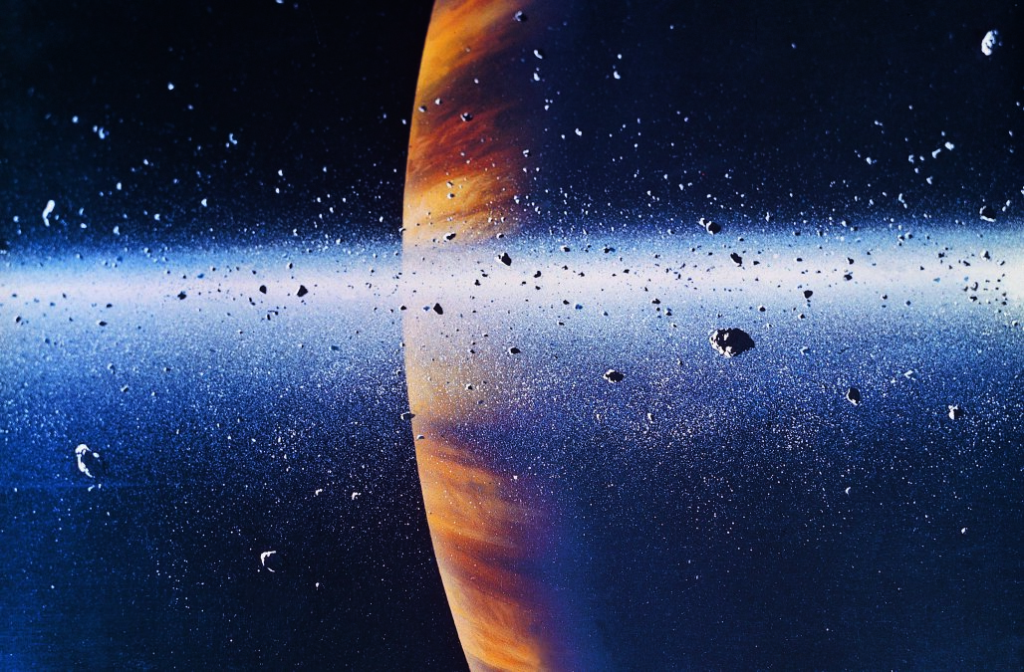
Saturn
All of the gas giants have rings, but Saturn’s are the largest.
The rings are only a few hundred meters thick.
The rings consist of icy particles that range in size from a few cm to several meters across.
Period of rotation 10 hours 30 minutes.
Period of revolution 29 years 155 days.
Diameter 120,536 km

Slide 18
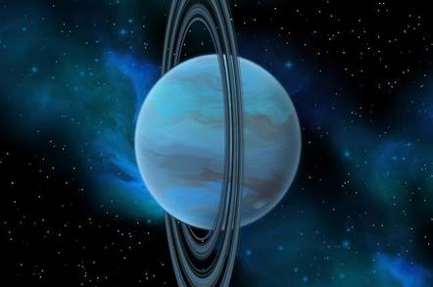
Uranus
Uranus has about 63 times the volume of Earth and is nearly 15 times as massive. Uranus is tipped over on its side; the axis of rotation is tilted by almost 90 degrees.
For part of a Uranus year, one pole points toward the sun while the other pole is in darkness.
The moons and the thin rings of Uranus all lie in a disk that is in the same plane as the equator of Uranus.
The orbits of Uranus’s moons are all tilted out of the plane of the solar system.

Slide 19
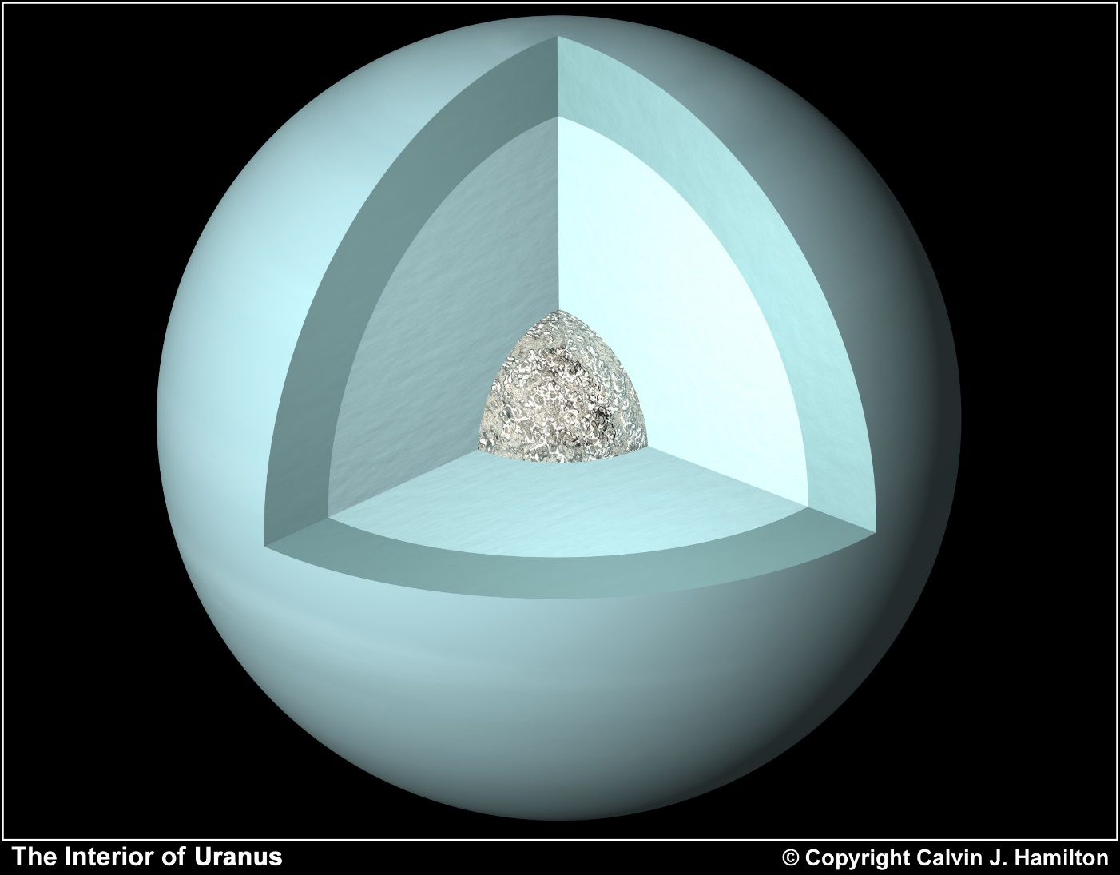
Uranus
Uranus was hit by a massive object that tipped the planet over.
Uranus was the first planet discovered with a telescope.
The atmosphere is mainly hydrogen and methane gas, which absorbs the red part of sunlight very strongly.
While Uranus is smaller than Jupiter and Saturn, it has similar densities.
This suggest that they have water in their interiors.
Period of rotation 17 hours 14 minutes.
Period of revolution 83 years 274 days
Diameter 51,118 km

Slide 20
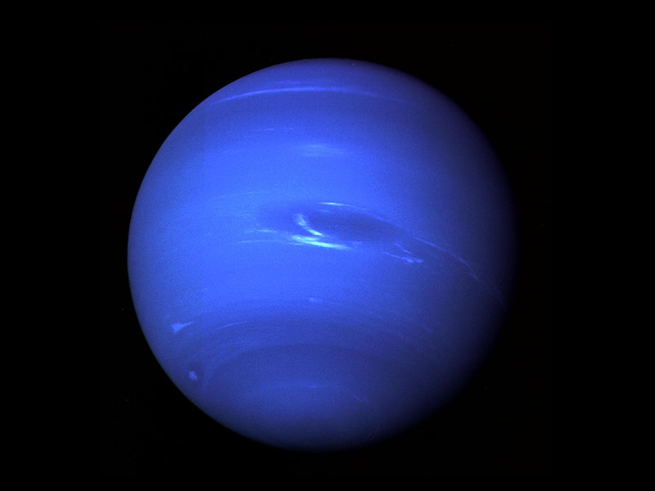
Neptune
Neptune was discovered in 1846.
Neptune’s atmosphere is nearly the same as that of Uranus.
Neptune’s’ atmosphere contains belts of clouds.
Neptune has a great dark spot similar to the great red spot on Jupiter.

Slide 21
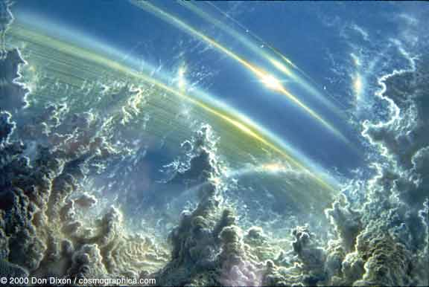
Neptune
Neptune’s interior release heat to its outer layers.
This helps the warm gases rise and cool gases sink, setting up the wind patterns in the atmosphere that create the belts of clouds.
Neptune also has very narrow rings.
Period of rotation is 16 hours 7 minutes
Period of revolution 83 years, 274 days.
Diameter 49,528 km

Slide 22
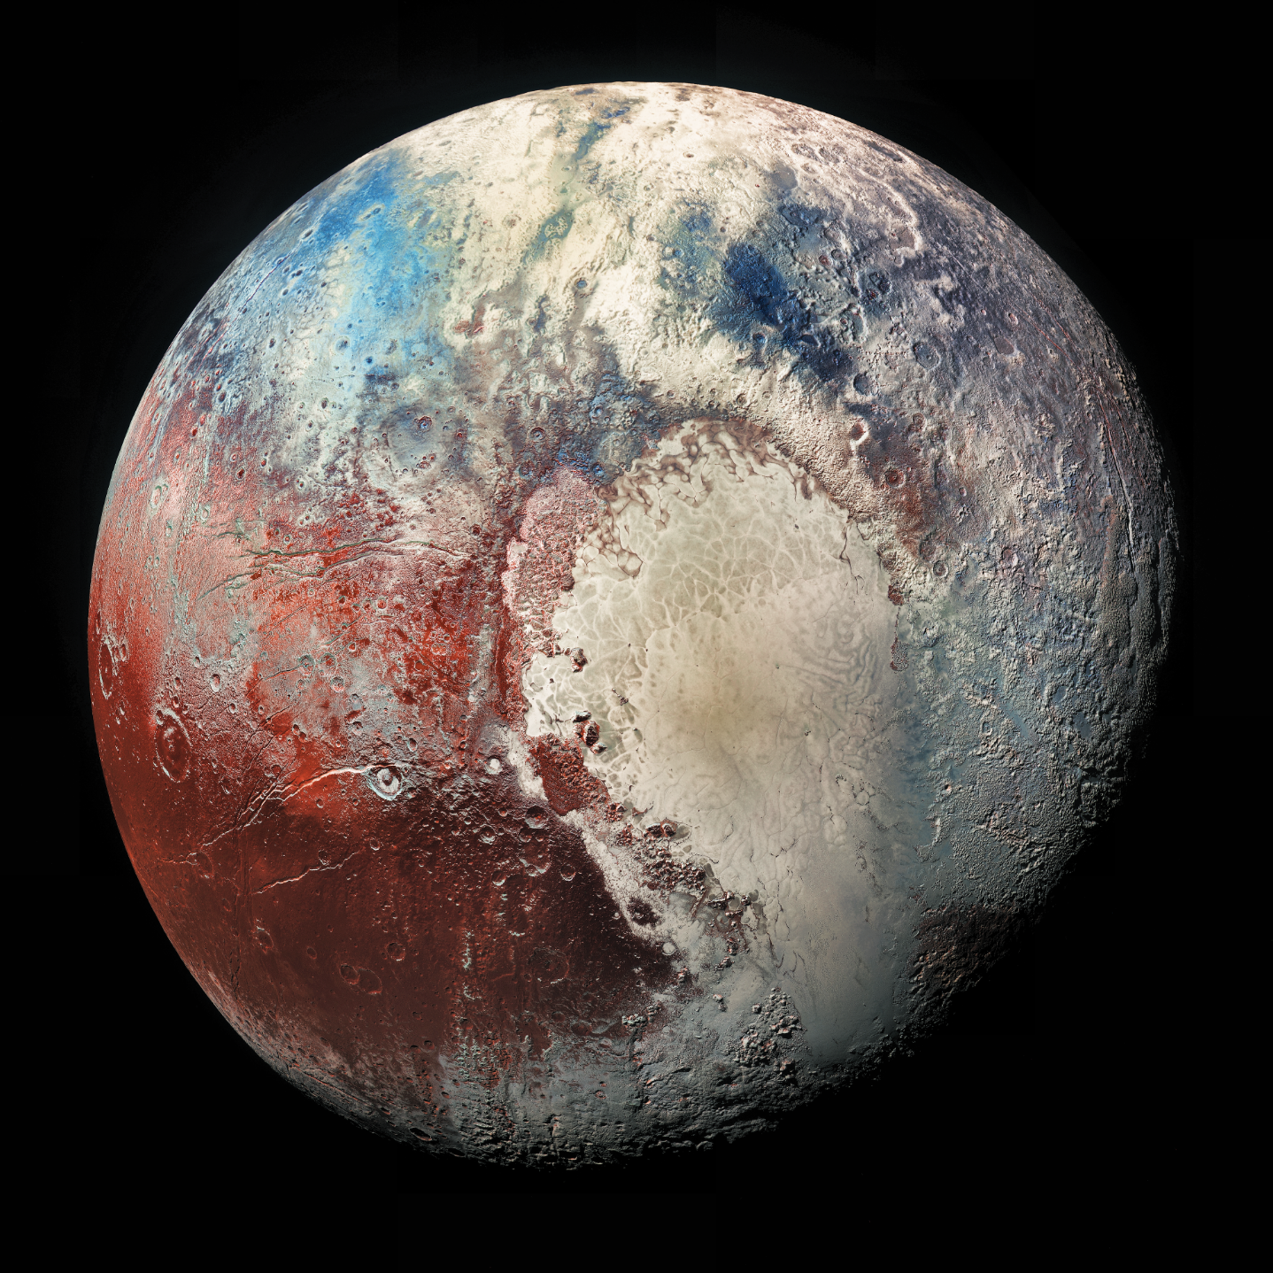
Pluto
Pluto is less than half the size of Mercury.
It’s moon Charon is more than half its size.
Pluto is made of rock and ice.
It has a very thin atmosphere of methane.

Slide 23
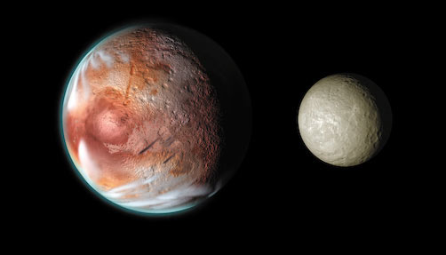
Pluto
Pluto is covered by nitrogen ice.
Charon is covered by water ice.
Period of rotation
6 days, 10 hours
Period of revolution 248 years

