Slide 1
astronomical unit | planetesimals | solar nebula
ellipse | revolution | solar system
nebula | rotation
orbit | period of revolution

Slide 2
Solar System

Slide 3
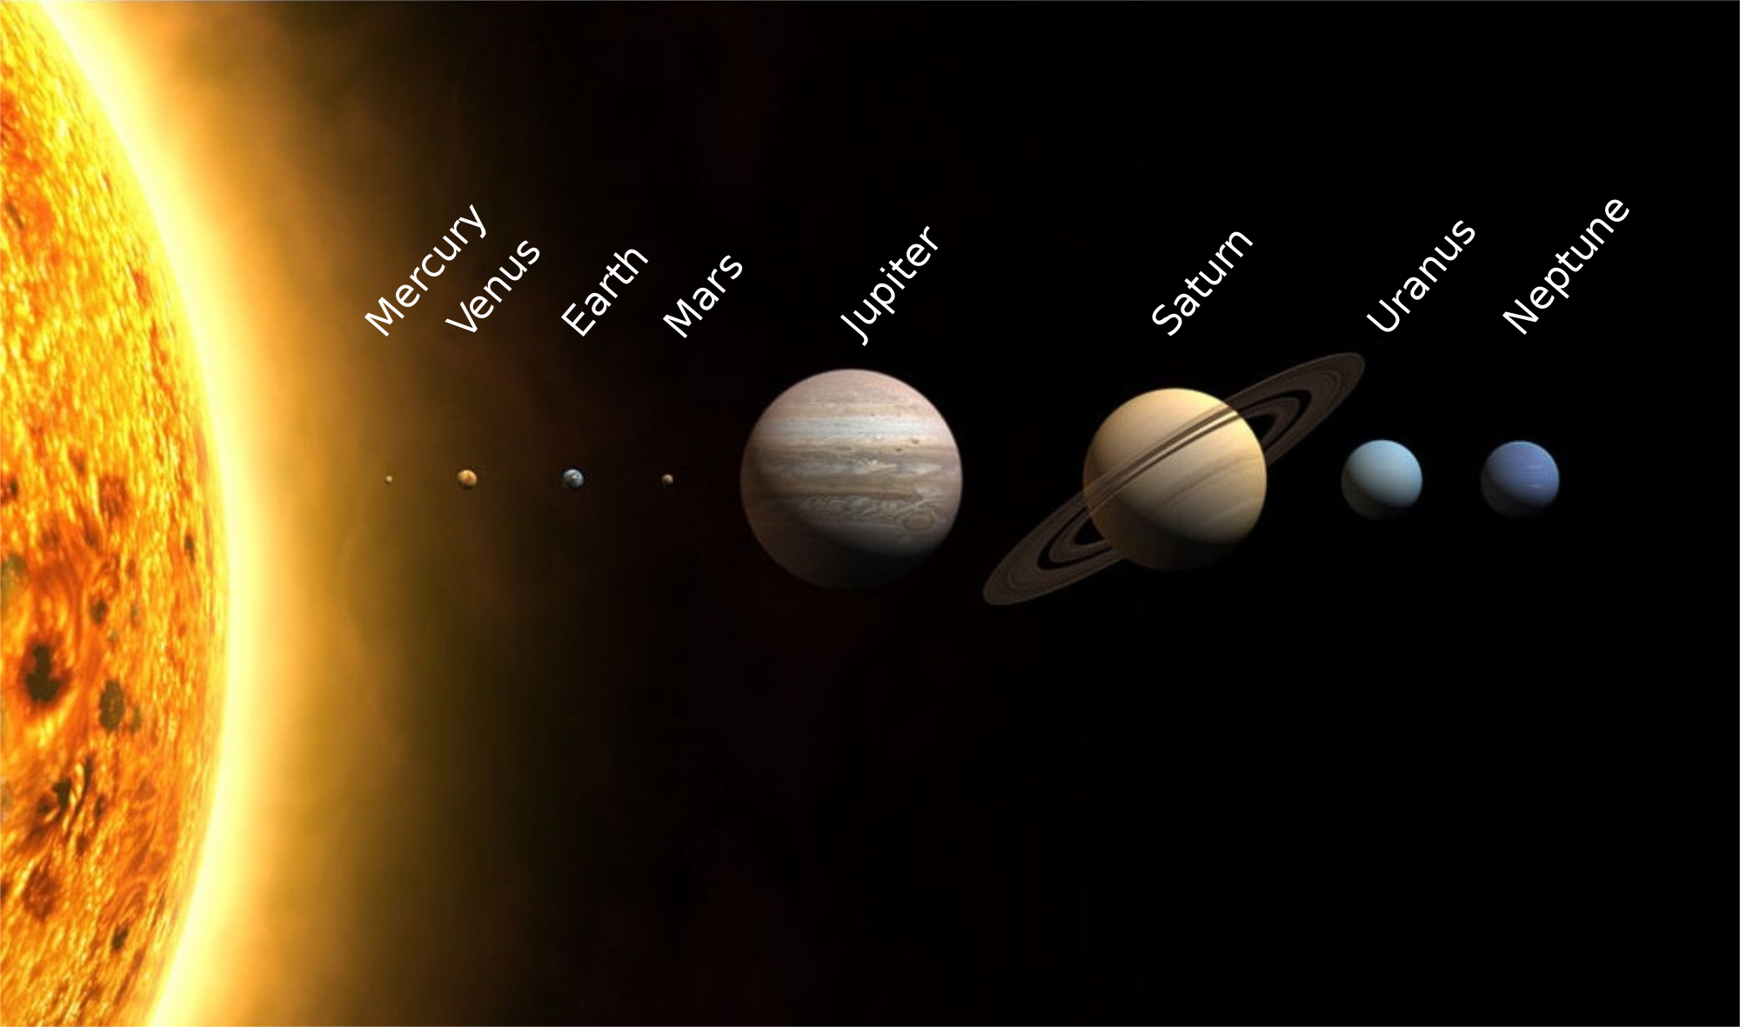
A Solar System Is Born
The solar system is composed of the sun and planets and other bodies that travel around the sun.

Slide 4
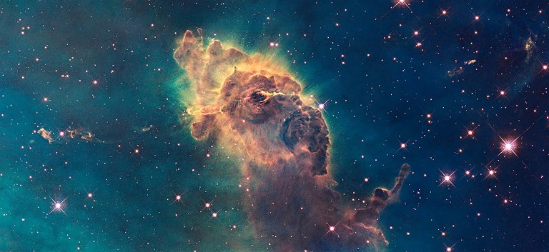
Solar Nebula
All the ingredients for building planets are found in the vast regions between the stars.
The “stuff between the stars” contains a mixture of gas and dust.
The gas is mostly hydrogen and helium, while the dust is made up of tiny grains of elements such as carbon and iron.

Slide 5
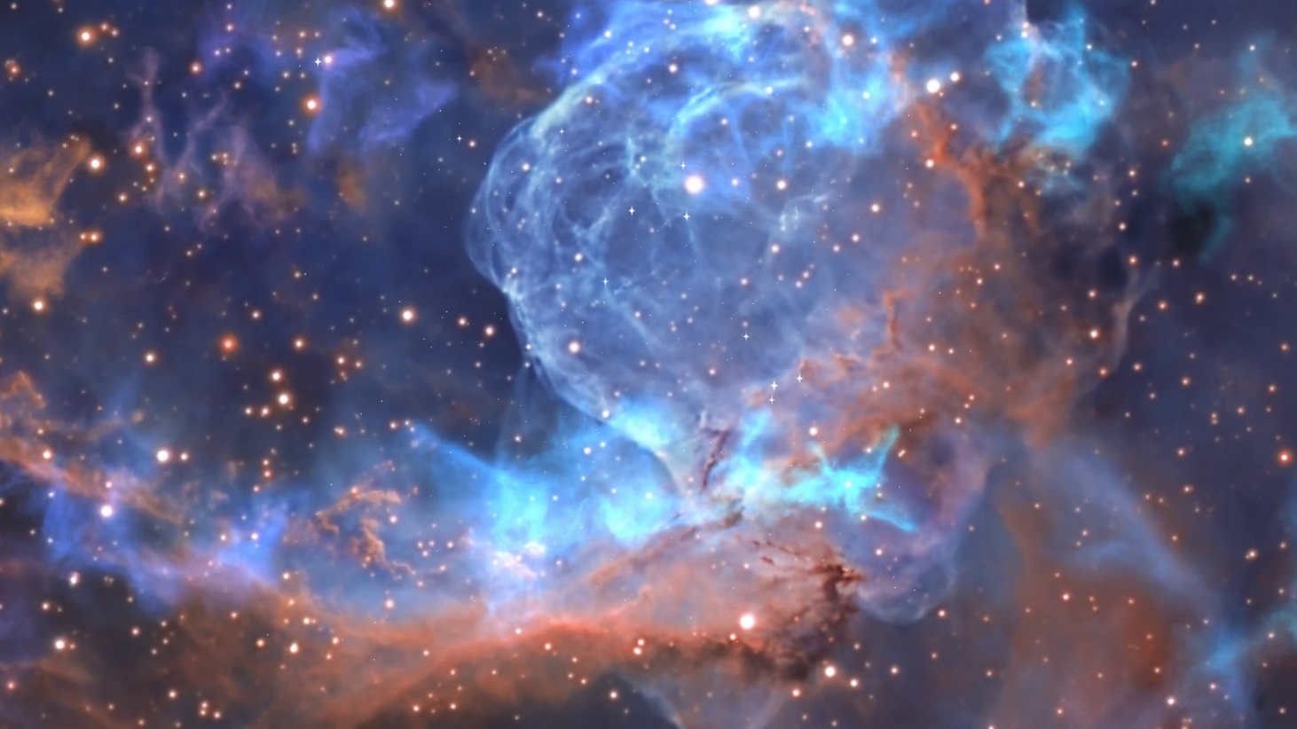
Solar Nebula
The dust and gas clump together in huge interstellar clouds called nebula.
The nebulas are cold, only 10 C above absolute zero, and dark.
Over time, light from nearby stars interact with dust and gas, and many new chemicals are formed.
The clouds are the first ingredients of a new planetary system.

Slide 6
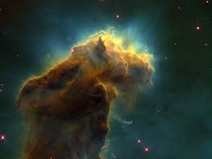
Gravity Pulls Matter Together
Because these clouds of dust and gas are matter, they have mass.
Mass is affected by the force of gravity.
Because the matter in a nebula are spread out, the attraction between the dust and gas particles is small.

Slide 7
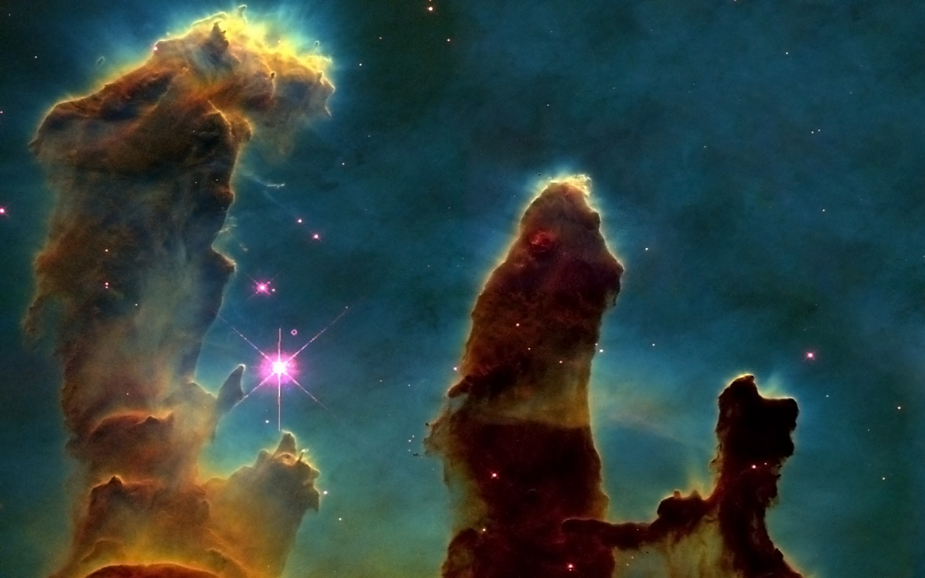
Gravity Pulls Matter Together
If a nebula’s density were, great enough the attraction between the particles might be strong enough to pull everything together into the center of the cloud.
However, even large clouds do not necessarily collapse toward the center because there is another force that pushes in the opposite direction from gravity.

Slide 8
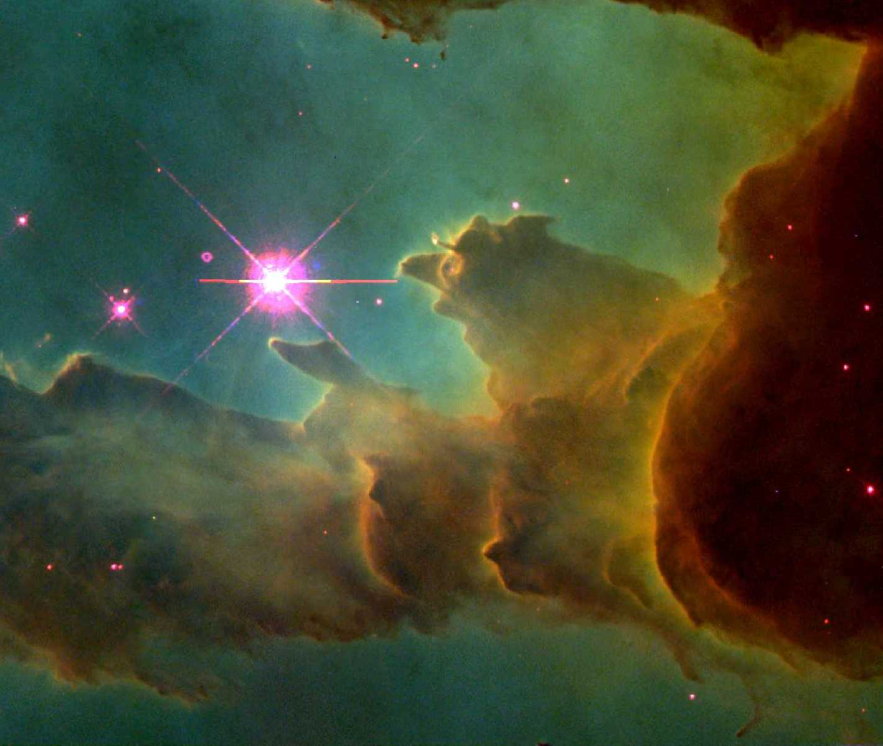
Pressure Pushes Matter Apart
Temperature is a measure of how fast particles in an object move around.
If the gas molecules move very slowly, the temperature is very low and the cloud is cold.
Because the cloud has temperatures above absolute zero, the gas molecules are moving.

Slide 9
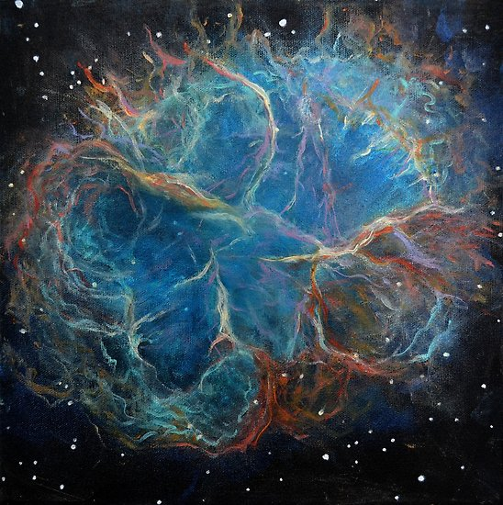
Pressure Pushes Matter Apart
Individual gas molecules can move in any direction.
Sometimes they crash into each other.
These collisions create a push or pressure away from the other gas particles.
The pressure is what finally balances the gravity and keeps the cloud from collapsing.

Slide 10
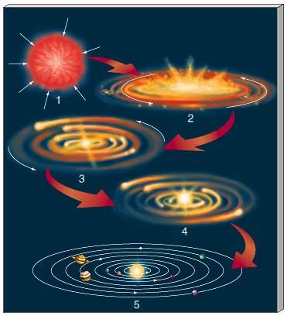
The Solar Nebula Forms
Sometimes something happens to upset the balance.
Two nebulas can crash into each other, or a nearby star can explode, causing material from the star to crash into the cloud.

Slide 11
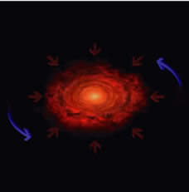
The Solar Nebula Forms
These events compress small regions of the cloud so that gravity overcomes the pressure.
At this point, the stage is set for the formation of a star and possibly planets.
The solar nebula is the name of the nebula that formed into our solar system.

Slide 12
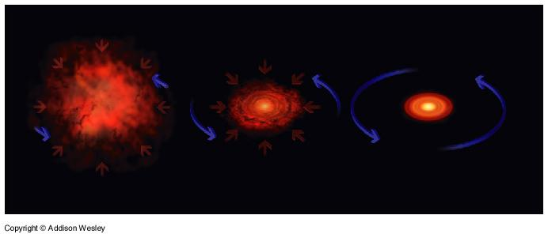
From Planetesimals to Planets
Once the solar nebula started to collapse things happened quickly (in astronomical terms).
As the dark cloud collapsed, matter in the cloud got closer and closer together.
This made the attraction even stronger because gravity increase with decreasing distance.

Slide 13
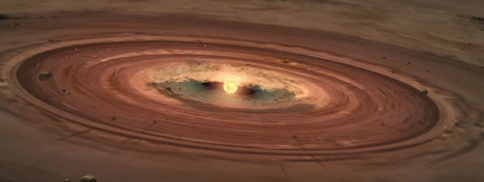
From Planetesimals to Planets
The stronger attraction pulled the cloud together, and the gas and dust particles moved at a faster rate, increasing the temperature at the center of the cloud.
As gas and dust gets more crowded near the center, particles begin to bump into other particles more often.

Slide 14
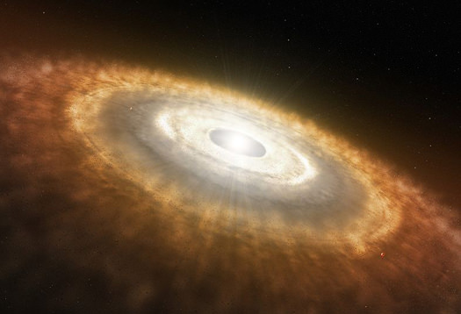
From Planetesimals to Planets
Eventually much of the dust and gas cloud began slowly rotating around the center of the cloud.
The rotating solar nebula eventually flattened into a disk.

Slide 15
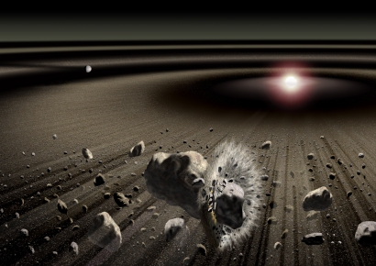
Planetesimals
Sometimes dust particles get such together when they collide.
As more dust particles began to stick together and grow in size, they formed the tine building blocks of planets called planetesimals.

Slide 16
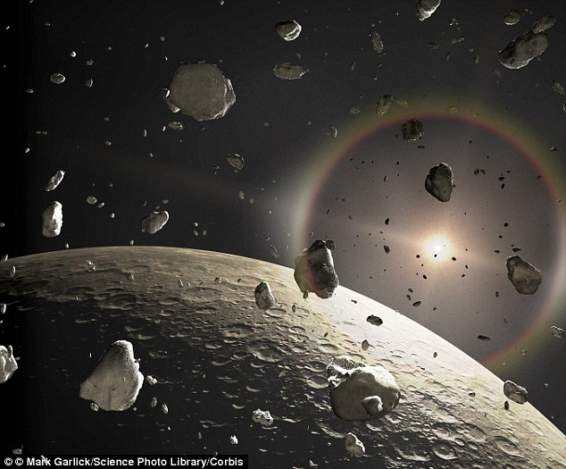
Planetesimals
Within a few hundred thousand years, the planetesimals grew from microscopic sizes to boulder sized.
The biggest planetesimals in each orbit started sweeping up most of the dust and debris in its path.
Eventually it became a planet.

Slide 17
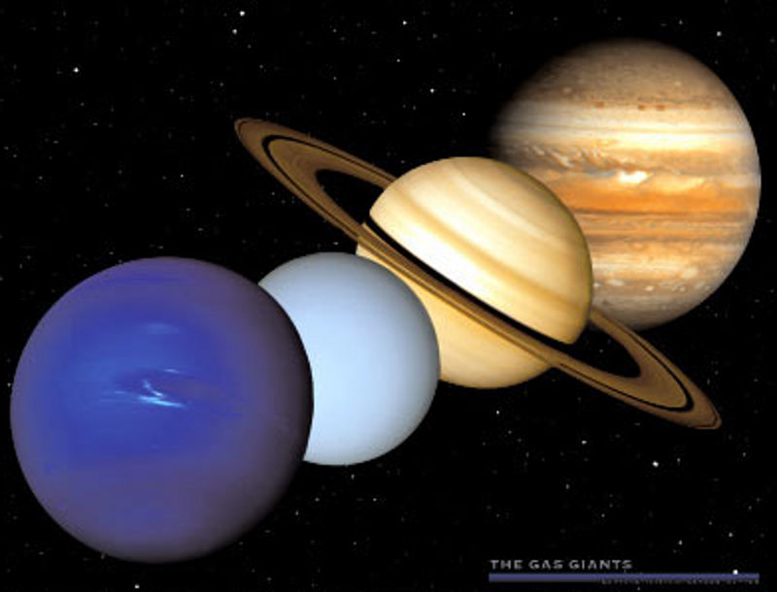
Planets
The giant gas planets—Jupiter, Saturn. Neptune am Uranus—were able to collect large amounts of dust in the cooler outer solar nebula.
Once they grew large enough, their gravity was strong enough to attract nebula gases, hydrogen and helium.
Far from the sun, it was cool enough for the giant planets to collect ices in addition to gases.

Slide 18
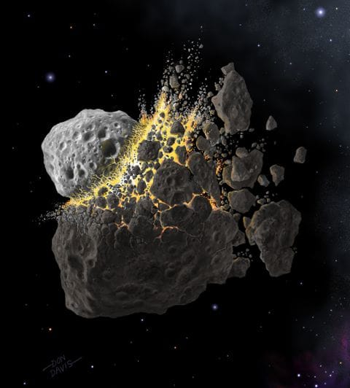
Planets
Closer to the sun, it was too hot for the gases to remain, so these inner planets are made of rocky material.
Collisions with smaller planetesimals became more violent and pieces became larger, leaving many craters on the surface of rocky planets.
In the final steps of planet formation, the remaining planetesimals crashed down on the planets, or were thrown to the outer edge of the solar nebula by the gravity of the larger planets.
Icey planetesimals became comets.

Slide 19
Birth of a Star
What is happening at the middle of the solar nebula?
The central part of the solar nebula became so hot the hydrogen fusion began.
This created so much pressure at the center of the solar nebula that outward pressure balanced the inward force of gravity.
At this point, the gas stopped expanding.
As the sun was born, the remaining gas and dust of the nebula was blown into deep space by strong solar wind.

Slide 20
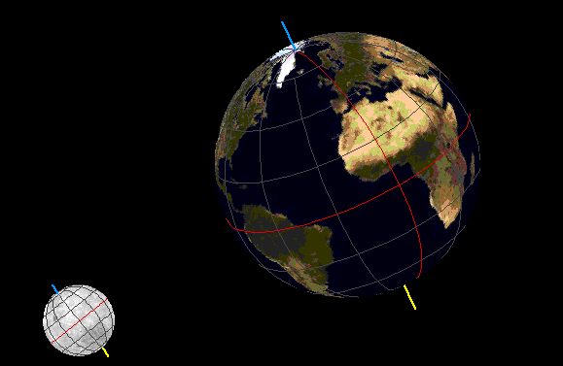
Planetary Motion
How does the motion of Earth cause day and night?
The Earth spins on its axis, this is rotation.
Only one-half of Earth faces the sun at any given time.
As the Earth rotates, different parts of the Earth receive sunlight.
The half facing the sun is day and the half facing away from the sun is night.

Slide 21
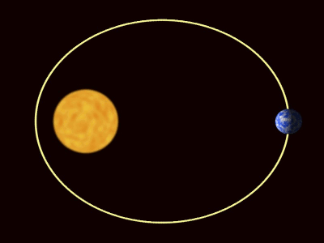
Planetary Motion
In addition to rotating, the Earth also travels around the sun in a path called an orbit.
The motion around the sun along its orbit is called revolution.
The other planets also orbit the sun.
The amount of time it takes for a single trip around the sun is called a period of revolution.
The period for the Earth to revolve around the sun is 365 days.

Slide 22
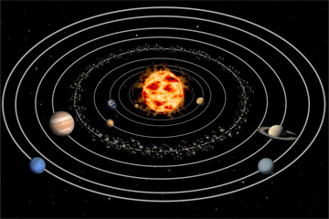
Planetary Orbits
Why do planets continue to revolve around the sun?
Why doesn’t gravity pull the planets toward the sun?
Danish astronomer Tycho Brahe carefully observed the positions of the planets.
When he died Johannes Kepler inherited his notes.

Slide 23
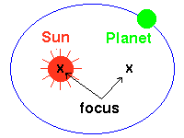
Kepler’s First Law of Motion
Kepler’s first discovery came from studying Mars.
He discovered that the planet did not move in a circle around the sun, but in an elongated circle called an ellipse.
An ellipse is an enclosed curve in which the sum of the distances from the edge of the curve to two points inside the ellipse is always the same.

Slide 24
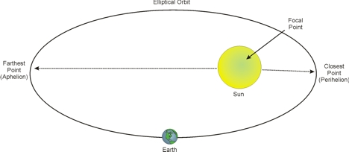
Kepler’s First Law of Motion
The maximum length of an ellipse is called its major axis and half the distance is called the semi major axis.
The semi major axis is used to give the size of the ellipse.
The semi major axis of Earth’s orbit is 150 million km.
It represents the average distance between the Earth and the sun and is called one astronomical unit (AMU).

Slide 25
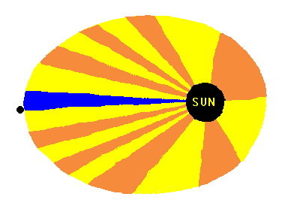
Kepler’s Second Law
Kepler also discovered that planets seem to move faster when they are close to the sun.
This is because Earth has to move faster to cover the same amount of area when it is closer to the sun.

Slide 26
Kepler’s Third Law
Kepler’s third law compares the period of a planets revolution with its semi major axis.
Kepler was able to demonstrate that by knowing a planet’s period of revolution, the plant’s distance from the sun can be calculated.
P²=a³
p=period of revolution
a= semi major axis

Slide 27
Newton’s Law of Universal Gravitation
Why do the planets closer to the sun move faster?
Isaac Newton reasoned that small objects fall toward Earth because they are attracted to each other by the force of gravity.
But because the Earth has so much more mass than the small object, only the small object appears to move.

Slide 28
Newton’s Law of Universal Gravitation
The law of universal gravitation states that the force of gravity depends on the product of the masses of the objects divided by the square of the distance between them.
Therefore when planets are closest to the sun they have the greatest amount of gravitational attraction, causing them to speed up.

