Slide 1
spectrum | main sequence | black hole
apparent magnitude | white dwarf
absolute magnitude | red giant
light year | supernova
parallax | neutron star
H-R diagram | pulsar

Slide 2
Stars

Slide 3
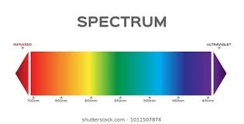
Compositions of Stars
When you look at a white light through a glass prism, you see a rainbow.
This rainbow of colors is called a spectrum.
The spectrum contains the colors we recognize as red, orange, yellow, green, blue, indigo, and violet.
A hot solid object, like the glowing wire inside a light bulb gives off a continuous spectrum—one that shows all of the colors.

Slide 4
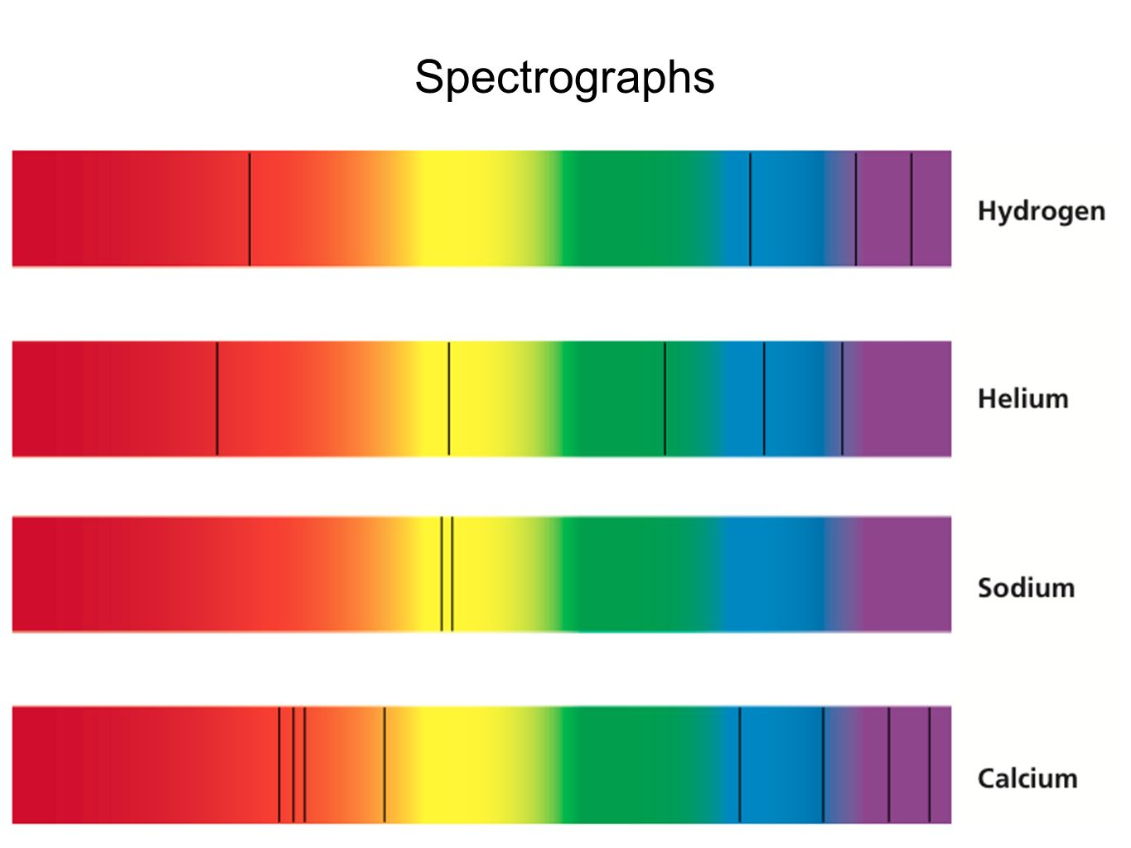
Compositions of Stars
Astronomers use an instrument called a spectrograph to spread starlight out into its colors.
Stars, however, don’t have continuous spectra.
Because they are not solid objects, stars give off spectra that are different from those of light bulbs.

Slide 5
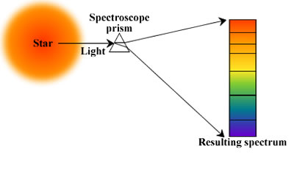
Making an I.D.
Stars are made of various gases that are so dense, they act like a hot solid.
For this reason, the surface of a star, or the part that we see, gives off a continuous spectrum.
But the light we see passes through the star’s atmosphere which is made of somewhat cooler gases than the star itself is made of.

Slide 6
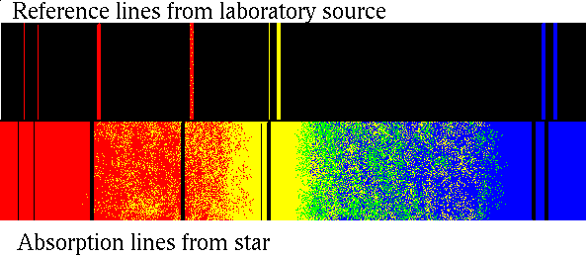
Making an I.D.
A star therefore produces a spectrum with various lines in it.
Emission lines are bright lines that are made when certain wavelengths of light are given off by hot gases.
Only some colors in the spectrum show up, while all other colors that make up white light are missing.
Emission lines are the fingerprints for the elements.

Slide 7
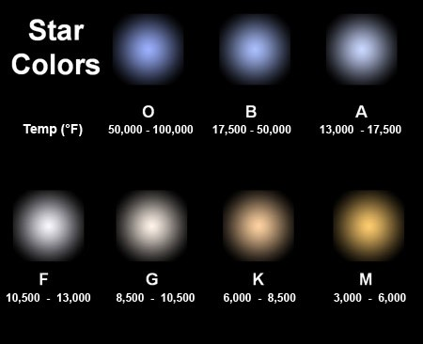
Classifying Stars
In the 1800s, the first people to look at spectra found that different stars had different spectra.
They started to collect the spectra of lots of stars and tried to classify them.
At first, letters were assigned to each type of spectra.

Slide 8
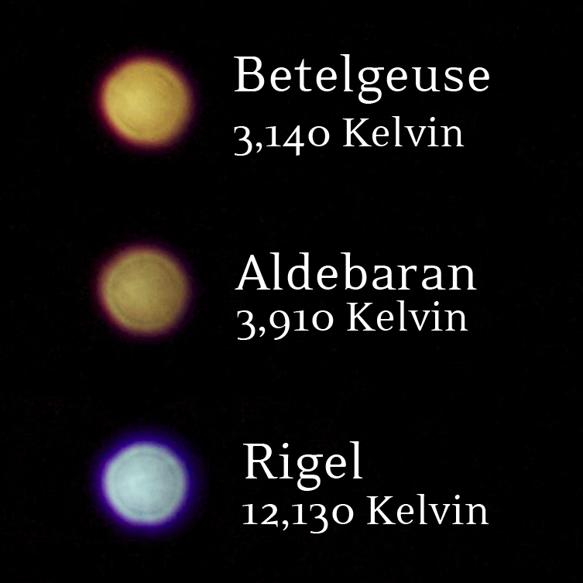
Classifying Stars
Stars with spectra that had very noticeable hydrogen patterns were classified as A type stars.
Others were classified as B and so on.
Later, when scientists finally understood why spectra are different they realized that the stars were classified in the wrong order.

Slide 9
Classifying Stars
Stars are now classified by how hot they are.
The main differences in the spectra of stars are related to the temperature of the stars.
We see the temperature differences as colors.
The original class O stars are blue—they are very hot.

Slide 10
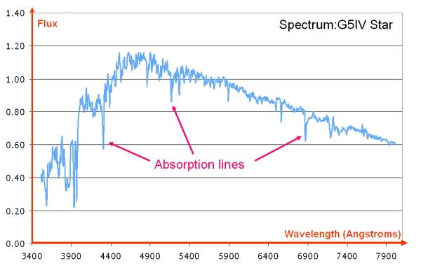
Classifying Stars
If you see a certain pattern of absorption lines in a star, you know that a certain element or molecule is in the star or at least in its atmosphere.
But the absence of a pattern doesn’t mean the element isn’t there; the temperature might not be high enough or low enough for absorption lines to be produced.

Slide 11
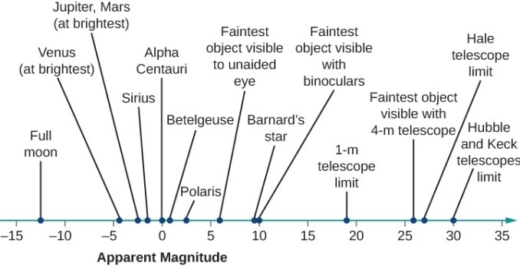
How Bright Is That Star?
Some stars are bright and some are faint.
The brightest stars are called first magnitude stars and the faintest stars are sixth magnitude stars.
Magnitude means size, or in this case brightness.

Slide 12
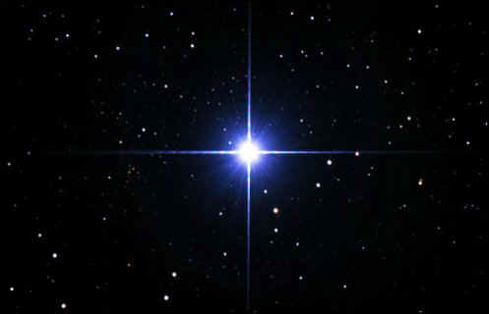
How Bright Is That Star?
A first magnitude star is 100 times bright than a sixth magnitude star.
A smaller number means a brighter star.
With telescopes we can see stars that are 29th magnitude.
Very bright stars may have a negative number.

Slide 13
Apparent Magnitude
Lights nearer to you look brighter than lights farther away.
How bright a light looks is called apparent magnitude.

Slide 14
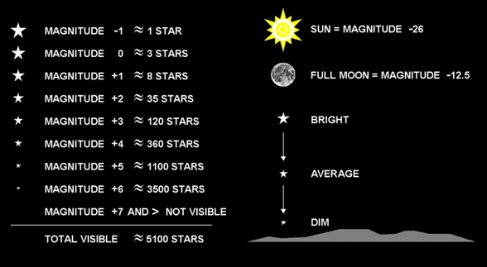
Absolute Magnitude
Astronomers use a star’s apparent magnitude and its distance from Earth to calculate its absolute magnitude.
Absolute magnitude is the actual brightness of a star.
If all stars could be placed the same distance away, their absolute magnitudes would be the same as their apparent magnitudes and the brighter stars would look brighter.

Slide 15
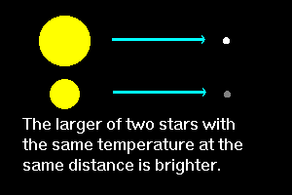
Absolute Magnitude
The sun, for example, has an absolute magnitude of 4.8—pretty ordinary for a star.
However, because the sun is so close to Earth, its apparent magnitude is -26.8, making it the brightest object in the sky.

Slide 16
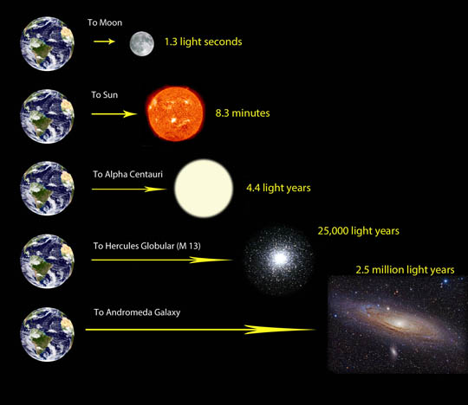
Distance to the Stars
Because they are so far away, astronomers use light-years to give the distances to the stars.
A light-year is the distance that light travels in one year.
Because the speed of light is about 300,000 km/s, it travels almost 9.5 trillion kilometers in one year.

Slide 17
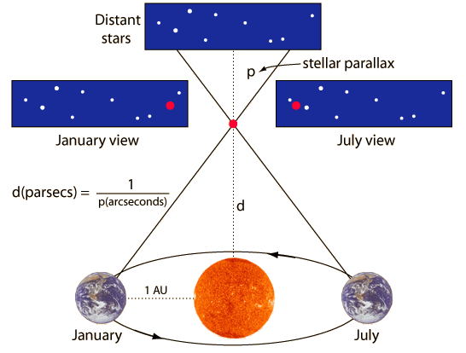
Distance to the Stars
Stars near Earth seem to move compared with more-distant stars as Earth revolves around the sun.
This apparent shift in position is called parallax.
While this shift can be seen only through telescopes, using parallax and simple trigonometry, astronomers can find the actual distance to stars that are close to Earth.
Farther stars, however, are measured in more-complicated ways

Slide 18
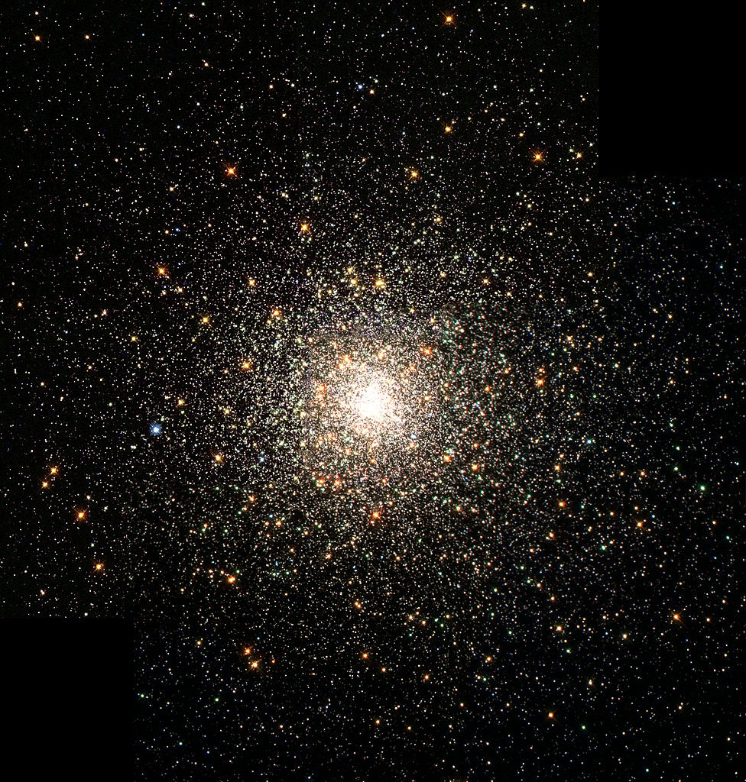
Motion of Stars
Earth rotates on its axis.
As the Earth turns, different parts of its surface face the sun.
This is why we have days and nights.

Slide 19
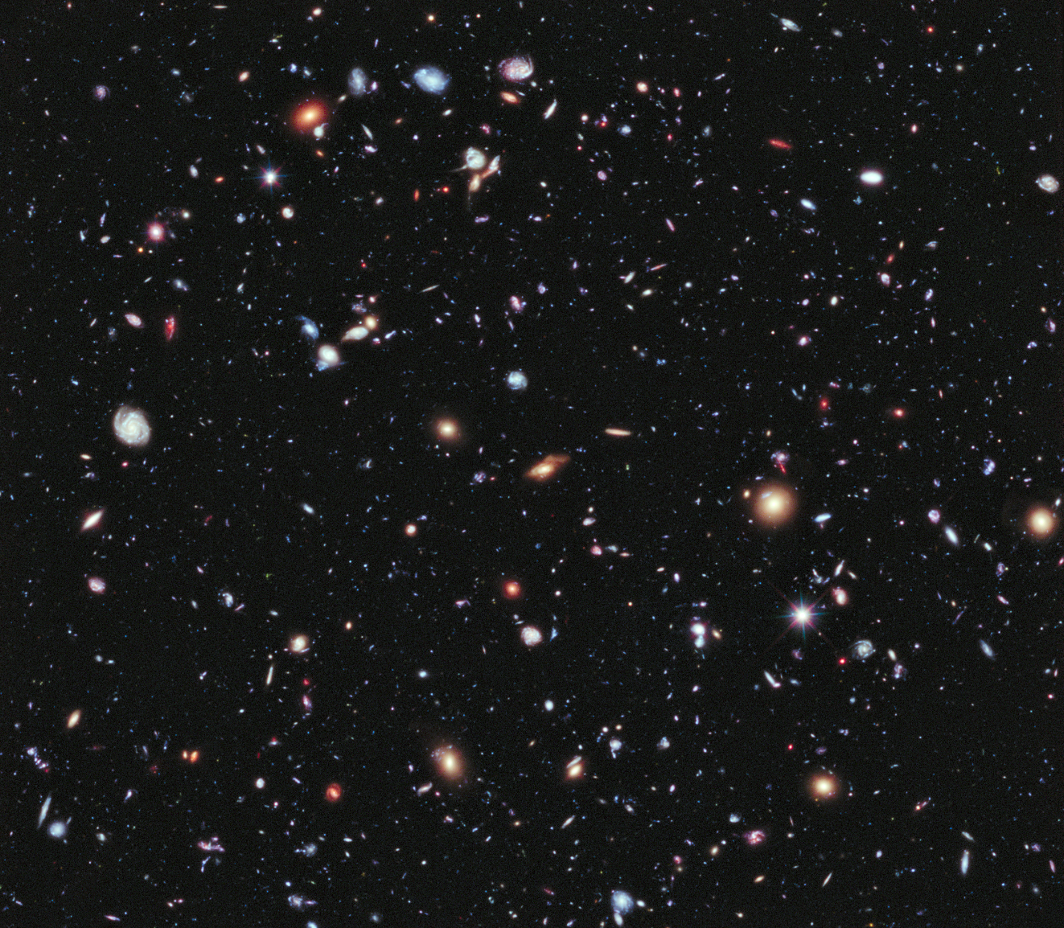
Motion of Stars
The Earth also revolves around the sun.
At different times of the year, you see different stars in the night sky.
This is because the side of Earth that is away from the sun at night faces a different part of the universe.

Slide 20
Apparent Motion
Because of our location on the Earth’s surface, the sun appears to rise in the east and set in tin the west.
Stars also seem to rise and set.
During the day the atmosphere scatters light from the sun and can’t see the stars because the sky is too bright.

Slide 21
Actual Motion
The rising and setting of the sun and stars is due to Earth's rotation.
But each star is also really moving in space.
Because the stars are so distant, though, their motion is hard for us to measure.

Slide 22
Actual Motion
Most of the stars nearest the sun are traveling in the same direction as the sun.
This is like driving on a highway while all the cars are going about the same speed and direction.
It would be difficult to measure the speed of the cars in the lane next to you by just watching them.
If you could watch stars over thousands of years, their movement would be obvious.

Slide 23
Life Cycle of Stars
Stars are born, grow old, and eventually die.
Stars exist for billions of years.
They are born when clouds of gas and dust come together and become very hot and dense.
As stars get older, they lose some of their material.

Slide 24
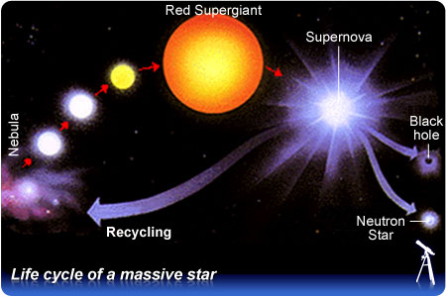
Life Cycle of Stars
Usually this is a gradual change, but sometimes it happens in a big explosion.
Either way, when a star dies, much of its material returns to space.
There some of it combines with more gas and dust to form new stars.

Slide 25
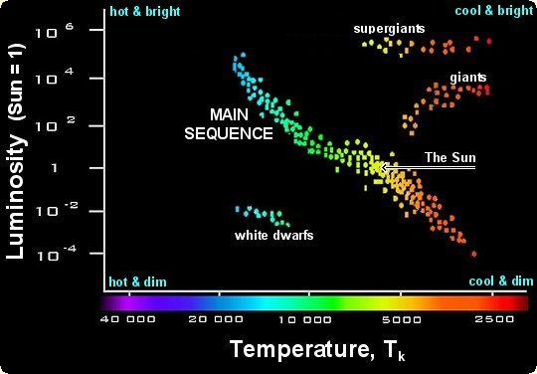
H-R Diagram
An H-R diagram is a graph showing the relationship between a star’s surface temperature and its absolute magnitude.
The H-R diagram shows how stars are classified by temperature and brightness.
It also is a good way to illustrate how stars change over time.
In an H-R diagram, temperature is given along the bottom of the diagram.

Slide 26
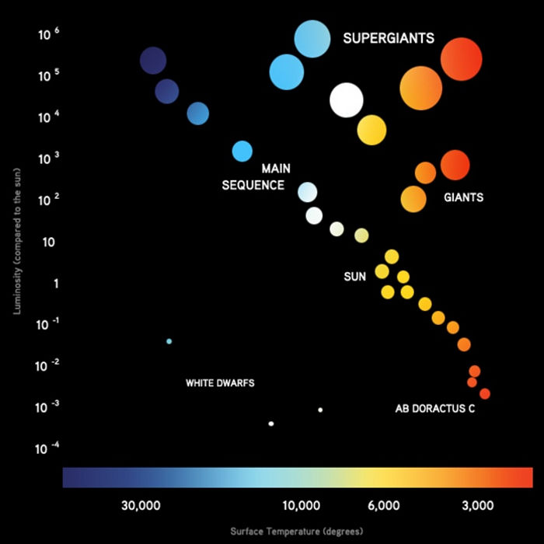
H-R Diagram
Absolute magnitude, or brightness, is given along the left side.
Hot blue stars are located on the left and cool red stars are on the right.
The brightest stars are a million times brighter than the sun.
The faintest are 1/10,000 as bright as the sun.

Slide 27
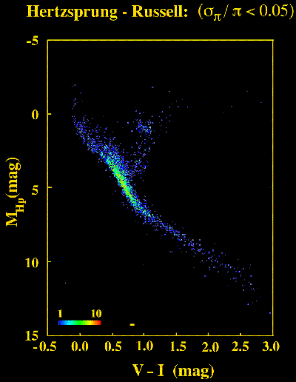
H-R Diagram
There is a band of stars going from the top left to the bottom right corner.
This diagonal pattern of stars is called the main sequence.
A star spends most of its lifetime as a main sequence star and then changes to one of the other types of stars.
All stars begin as a ball of dust and gas in space.

Slide 28
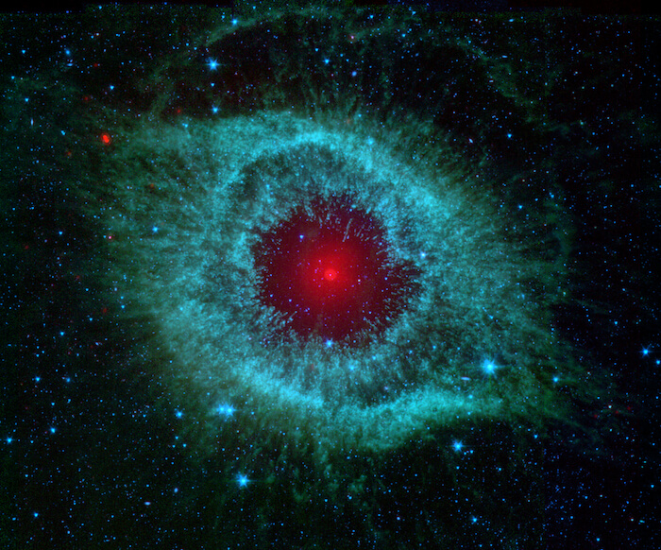
H-R Diagram
Gravity pulls the gas and dust together.
The gas becomes hotter as it becomes more dense.
When it is hot enough in the center, hydrogen turns into helium in a process called nuclear fusion, and lots of energy is given off.
Most stars can be plotted on the main sequence.

Slide 29
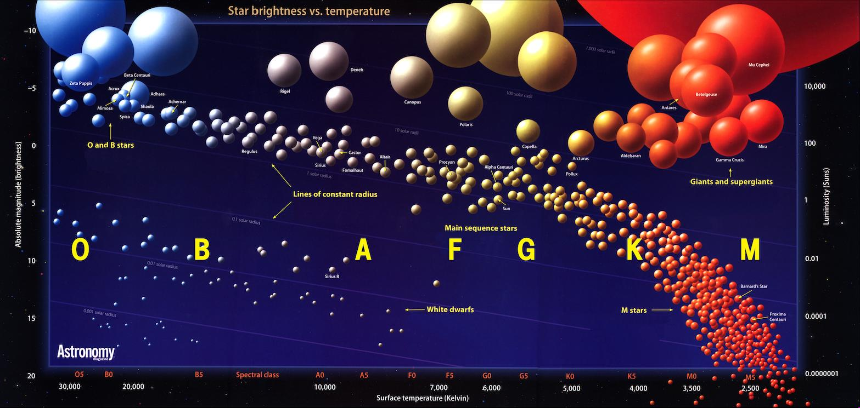
H-R Diagram
Small mass stars tend to be located at the lower right end of the main sequence; larger stars are found at the left end.
As main sequence stars age, they move up and to the right on the H-R diagram to become giants or super giants.
Such stars can then lose their atmospheres, leaving small cores behind, which end up in the lower left corner of the diagram as white dwarfs.

Slide 30
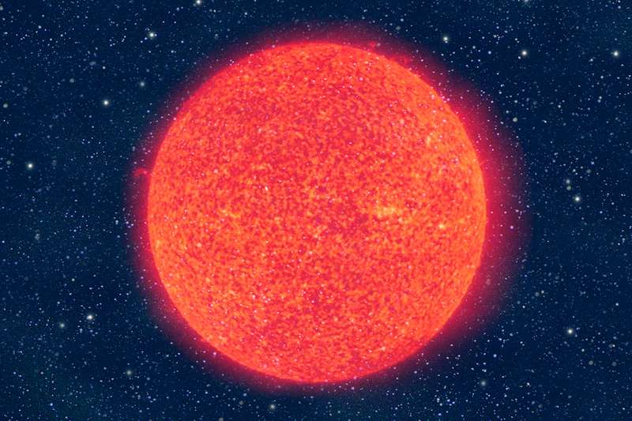
When Stars Get Old
While stars may stay on the main sequence for a long time, they don’t stay there forever.
Average stars, such as the sun, turn into red giants and then white dwarfs.
More massive stars may leave the main sequence in a more spectacular fashion.

Slide 31
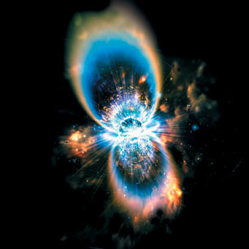
Supernovas
Large blue stars use up their hydrogen much faster than stars like the sun.
This means they make a lot more energy, which makes them very hot and therefore blue.
Compared with other stars they don’t last long.
At the end of its life, a blue star may explode in a tremendous flash of light called a supernova.

Slide 32
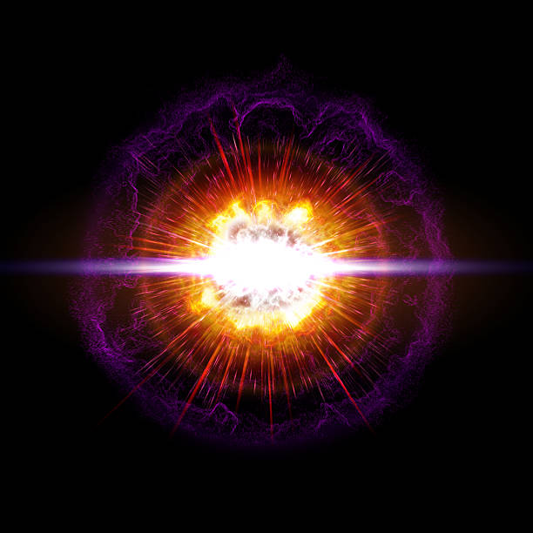
Supernovas
A supernova is basically the death of a large star by explosion.
A supernova explosion is so powerful it can be brighter than an entire galaxy.
It may shine for several days after the initial explosion and then gradually dim.
Heavy elements such as silver, gold, and lead are made during a supernova explosion and then scattered into space.

Slide 33
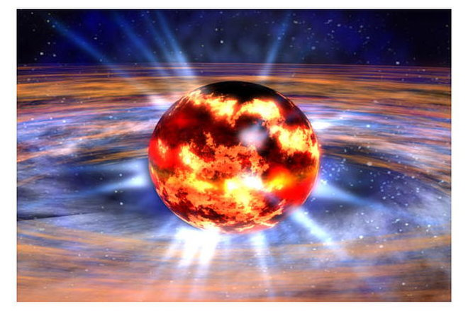
Neutron Stars and Pulsars
What happens to a star that becomes a supernova?
The leftover materials in a the center of a supernova are squeezed together to form a star of about two solar masses.
But all the material is found in a sphere only about 20 km in diameter.

Slide 34
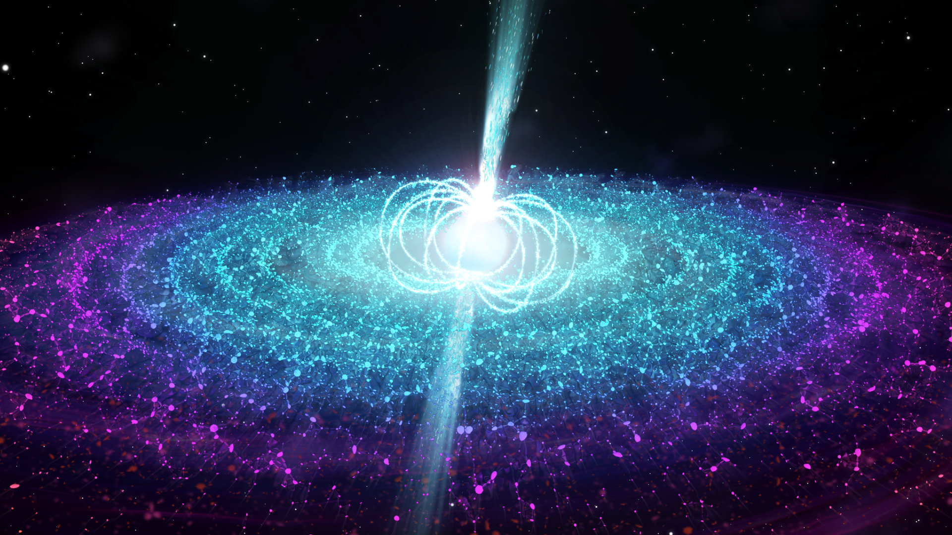
Neutron Stars and Pulsars
The particles inside the star become neutrons, so this sat is called a neutron star.
The squeezed material in a neutron star is so dense, a teaspoon of neutron star matter brought back to Earth would weigh a billion tons.

Slide 35
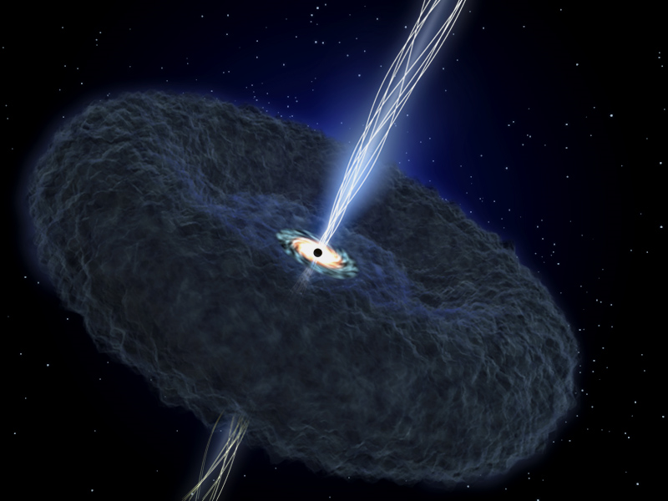
Neutron Stars and Pulsars
If a neutron star is also spinning, it is called a pulsar.
A pulsar sends out beams of radiation that also spin around very rapidly.
These beams are much like the beams from a lighthouse.

Slide 36
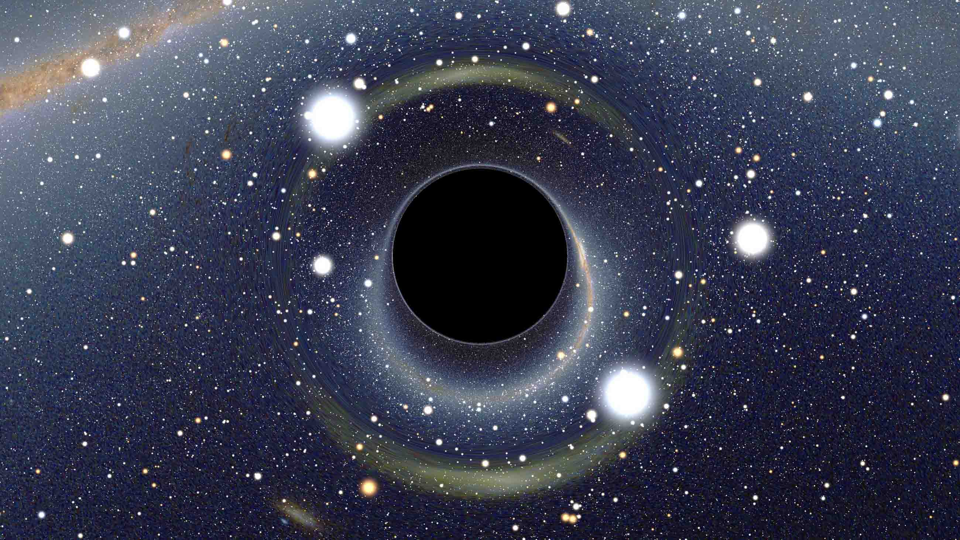
Black Holes
Sometimes the leftovers of a supernova are so massive that they collapse to form a black hole.
A black hole is an object with more than three solar masses squeezed into a ball only 10 km across.

Slide 37
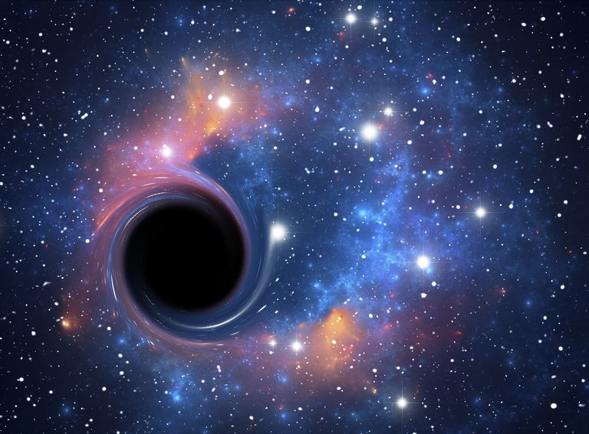
Black Holes
A black hole is so small and massive and its gravity is so strong that not even light can escape.
Black holes don’t gobble up stars.
If a star is close by, some gas or dust from the star will spiral into the black hole, giving off x rays.
It is by these x rays that astronomers can detect the existence of black holes.

