Slide 1
Your Credit Report and Credit Score

Slide 2
CREDIT DEFINITIONS
Credit
Trust given to another person for future payment of a loan, credit card balance, etc.
Creditor
A person or company to whom a debt is owed.

Slide 3
How it works
Three credit reporting companies update and distribute consumers’ information: Equifax, Experian and TransUnion
Consumer applies
for credit
Creditor requests information about consumer’s financial history
Credit profile used to determine whether to authorize credit—and if so, at what interest rates
Credit grantor reports activities back to credit reporting companies every 30 days
Credit reporting companies update consumer’s information
Consumer is granted (or denied) credit

Slide 4
WHAT IS A CREDIT SCORE?
A credit score is a number that helps a lender predict how likely an individual is to repay a loan, or make credit payments on time.
A credit score is a number that changes as the elements in a credit report change.
A credit score has broad use and impact. Your credit past is your credit future.
FICO® scores, one of the most common credit scoring systems, vary between 350 and 850.
VantageScoreSM, a new credit scoring system developed by the three credit bureaus, ranges from 501-990.

Slide 5
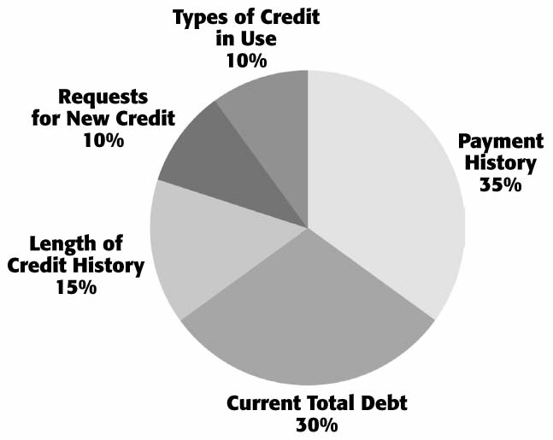
WHAT MAKES UP A TYPICAL
CREDIT SCORE?

Slide 6
What’s a good credit score?
Typically the higher the score the better
Individual credit grantors decide range of acceptability
For example, a consumer’s credit score might be 680
Based on this particular model, here is how the consumer may be viewed by a certain lender
300
400
500
600
700
800
900
You are here
Very
poor
Poor
Fair
Good
Very good
You are here

Slide 7
The Cost of a Good and Bad Credit Score
Your Credit score: | Your interest rate: | Your monthly payment:
760 - 850 | 6.13% | $1,313
700 - 759 | 6.35% | $1,344
680 - 699 | 6.53% | $1,369
660 - 679 | 6.74% | $1,400
640 - 659 | 7.17% | $1,462
620 - 639 | 7.72% | $1,543

Slide 8
Your credit history matters!
A good credit history will help you access services to improve your quality of life
A bad credit history will hold you back–and your missteps will follow you for as long as 10 years

Slide 9
IMPROVING YOUR CREDIT SCORE
Pay bills on time.
Get current and stay current.
Don’t open a lot of new accounts too rapidly.
Correct mistakes.
Shop for loan rates within a focused period of time.
Keep balances low on revolving credit.
Pay off debt.
Check your credit report.

Slide 10
Questions?

